Slide 1
ASSIGNMENT 7
Sejal Pradhan

Slide 2

Q. Create your own music album by creating song/rhyme for any two of the techniques discussed, one for the infant/toddler classroom and one for the preschool classroom.
ANS - Children are naturally drawn to music, experiencing its rhythms and melodies both physically and emotionally. Music and movement play a vital role in children's development, supporting growth across physical, emotional, social, and cognitive domains. During the early years, children develop new motor skills and discover that movement can communicate messages and represent actions. Physical expression becomes a powerful tool for self-discovery and interaction.

Slide 3
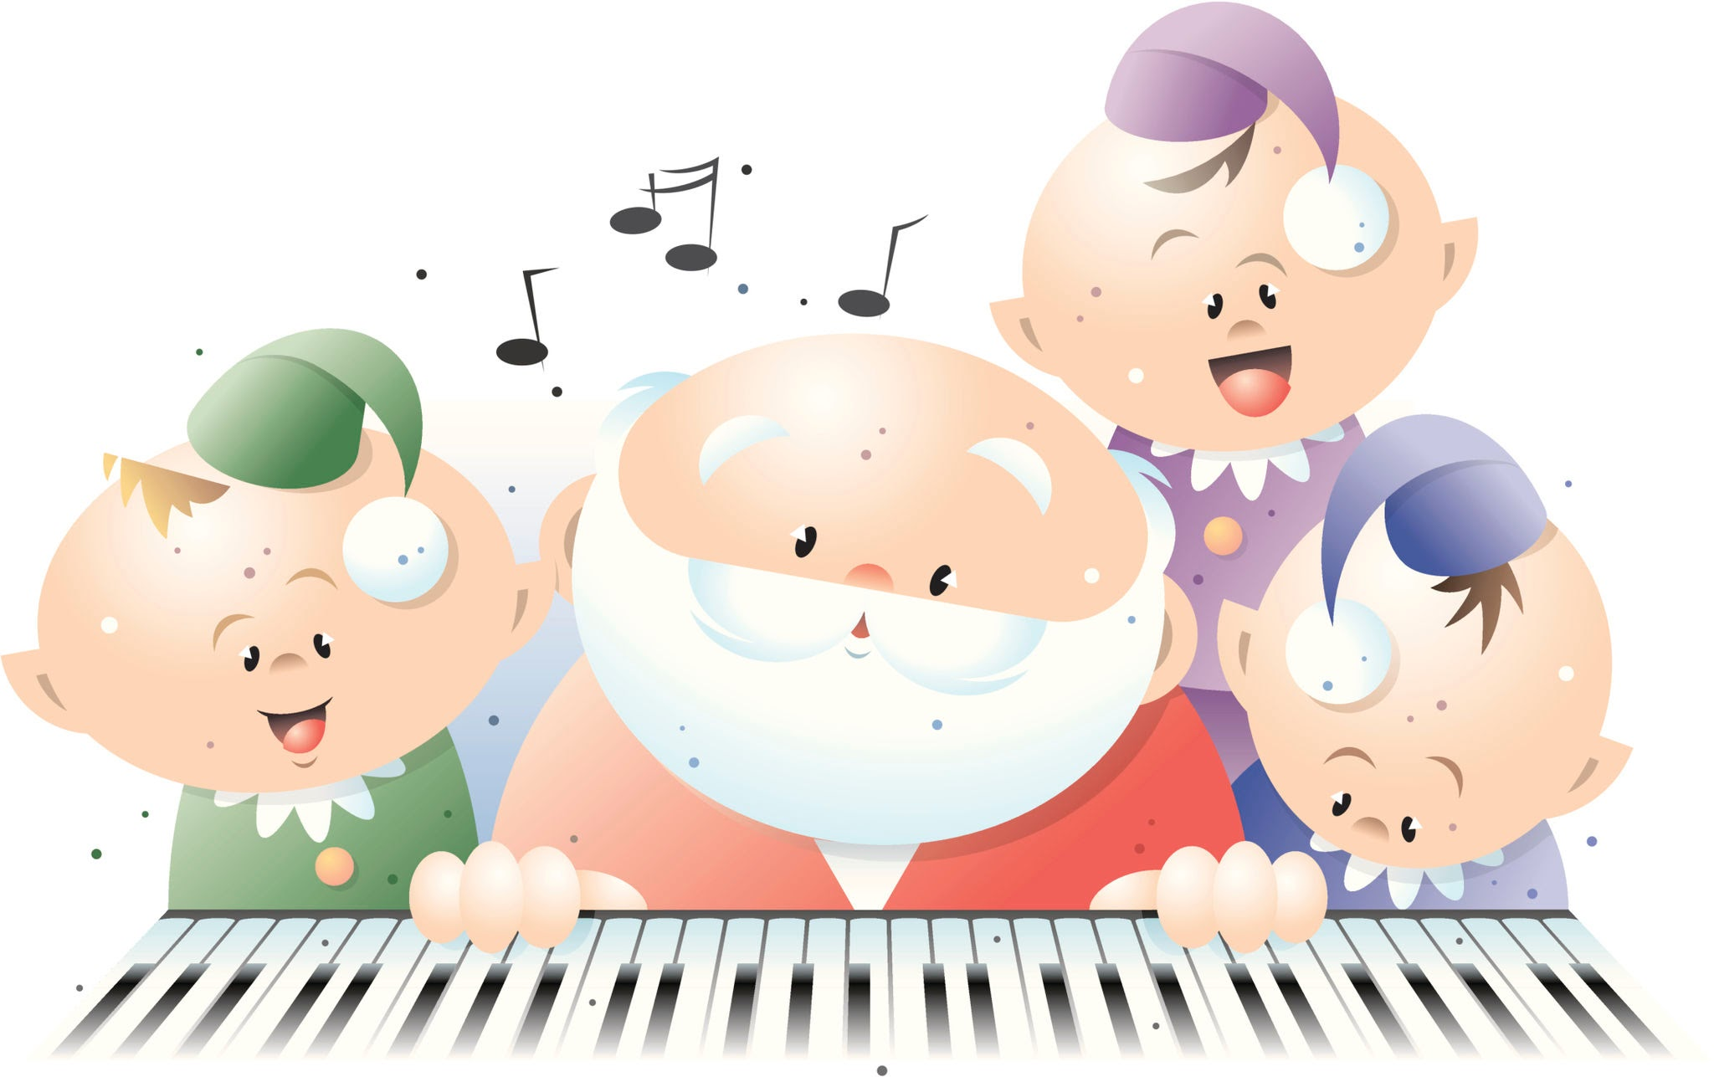
Singing and chanting help make routines and activities smoother and more fun!
And music helps to set a mood. Quiet, soothing music calms and relaxes children, while a lively marching tune rouses them for energetic clean‐up time. Music and movement are also social activities that help children feel part of the group.

Slide 4
Music brings another dimension of beauty into our lives. Music and movement benefit a child’s development in many ways.
Listening skills
Confidence and creativity
Social skills
Enhances memory
Motor skills

Slide 5
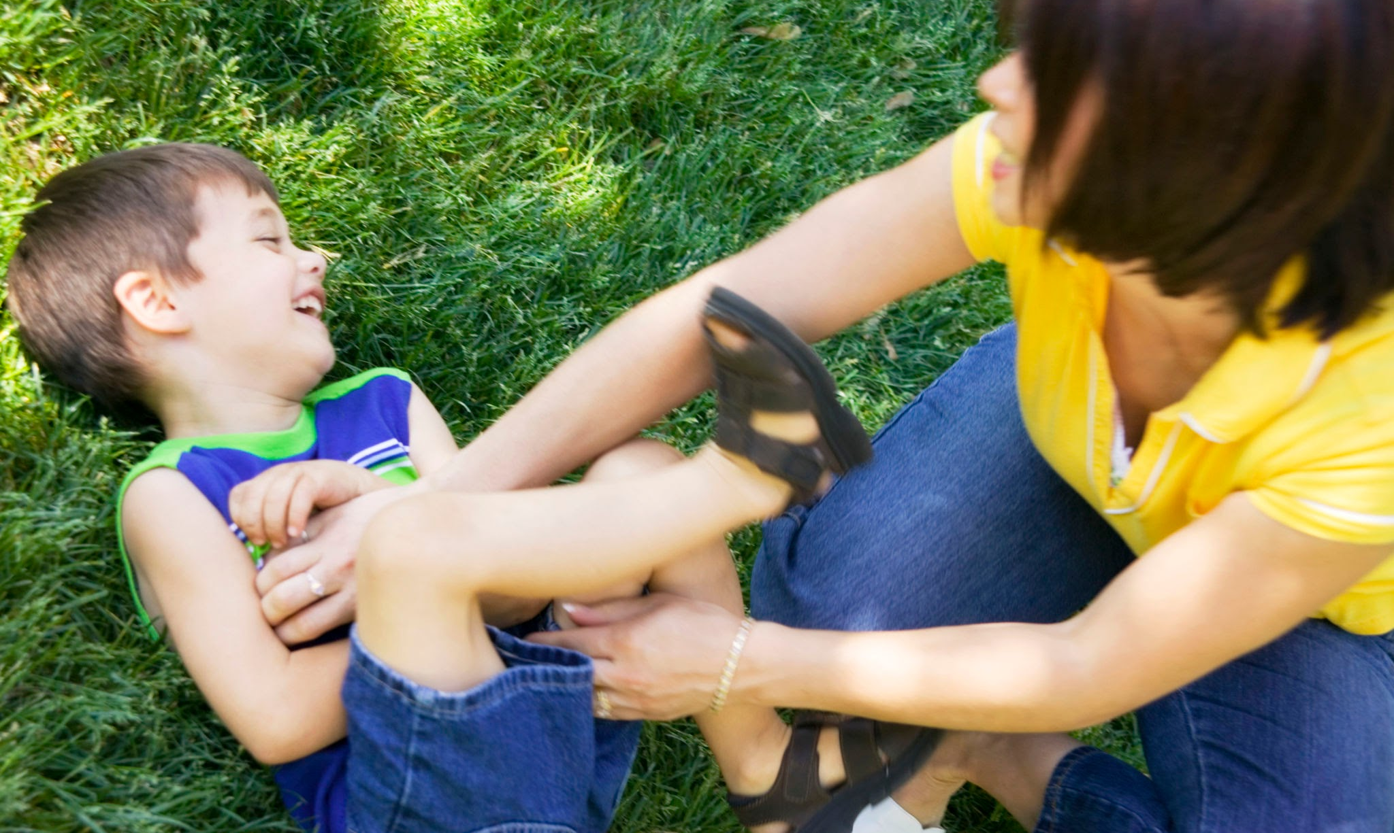
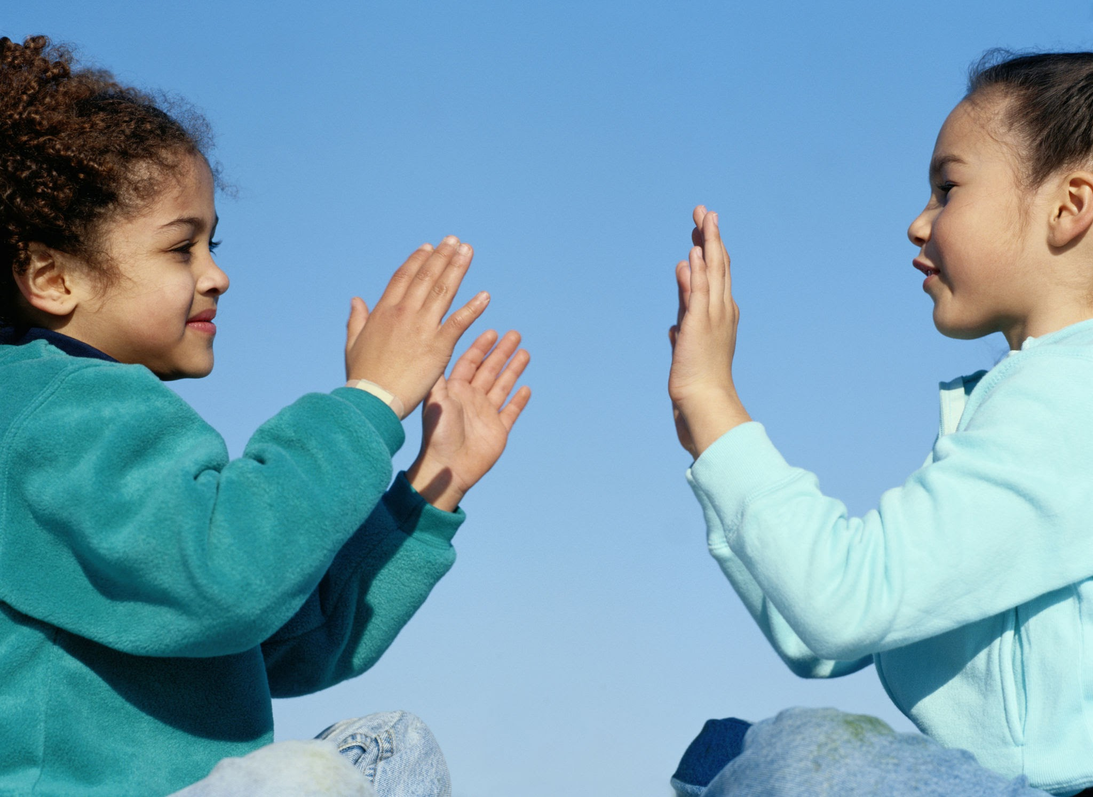
Rhythym
is more than just a musical element; it's a tool that can enhance various aspects of child development. Techniques such as-
Bouncing
Wiggling
Tickling
Finger play
Tapping
Clapping
are excellent ways to introduce rhythm to children.

Slide 6
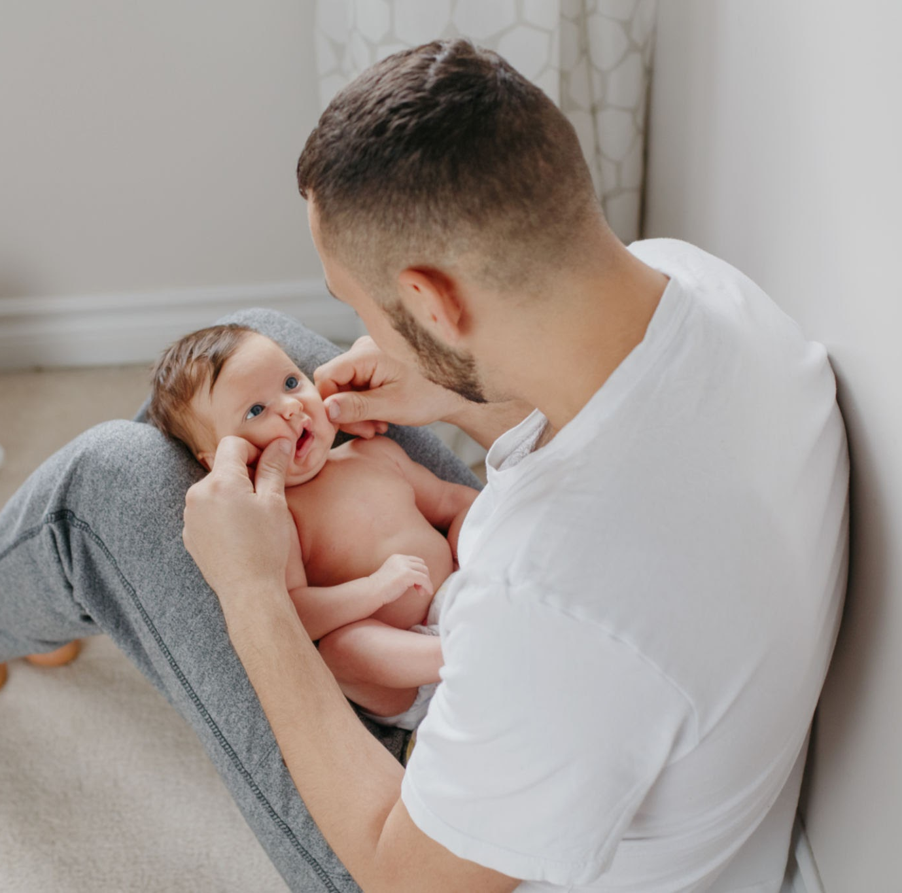
Let's explore how rhythm benefits development of children in different age groups
For Infants and Toddler classroom
At this age, children depend on their environment to learn how to talk, walk, and act. They observe the adults around them and try to imitate their movement and way of speaking, which helps their development. For speech, children in this age group are still in the process of learning how to speak clearly, so they tend to babble and copy simple sounds. At this stage, simple, engaging, and soothing rhymes help get their attention. We can use bouncing or tickling techniques while singing songs such as ‘Bouncing Bouncing one two three...’ or ‘Tickle Tickle Tickle...’.

Slide 7
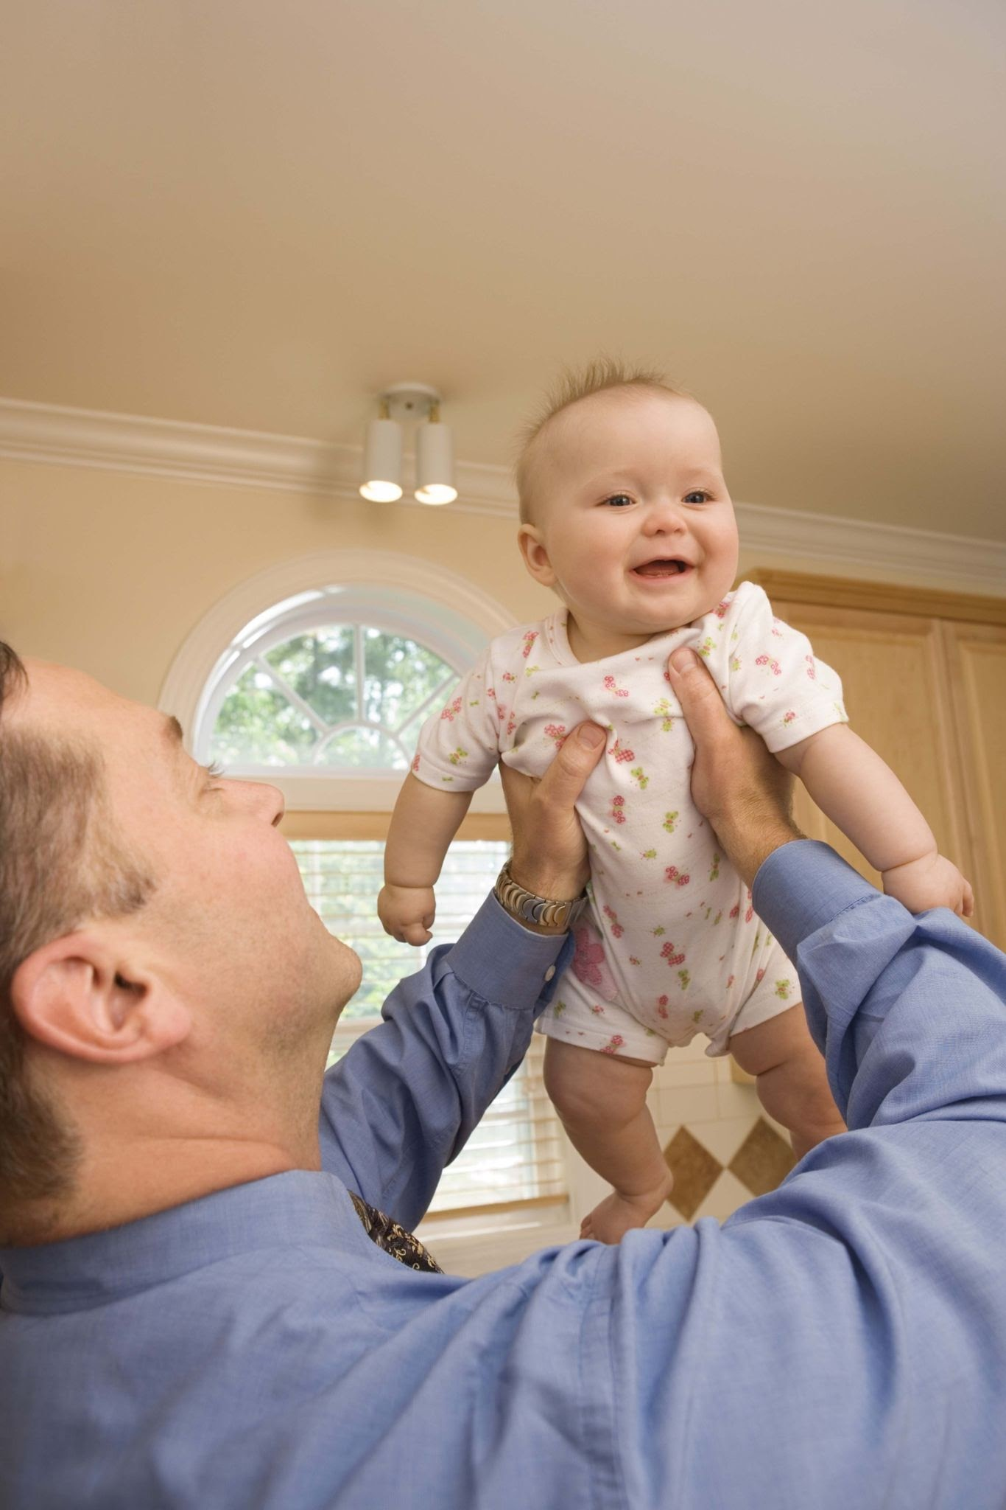
Bouncing Bouncing 123
A bouncing bouncing 123 123 123
A bouncing bouncing 123
A baby and me
Clapping clapping 123 123 123
Clapping clapping 123
A baby and me
(Song will be uploaded separately on website)

Slide 8
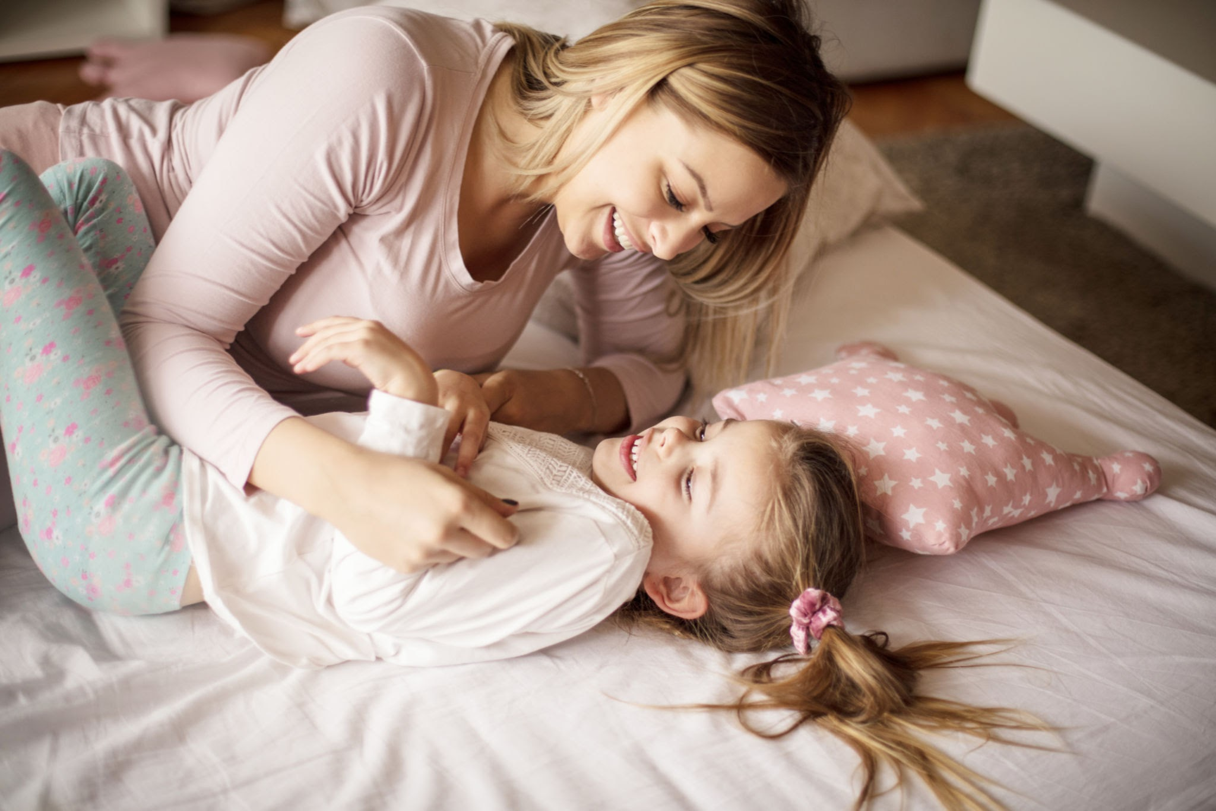

Tickle Tickle Tickle
Tickle tickle tickle
Tickle on my nose (and repeat again)
Tickle on my belly
Tickle in the air
Wiggle wiggle my feet
And mess up all my hair
(Song will be uploaded separately on website)

Slide 9
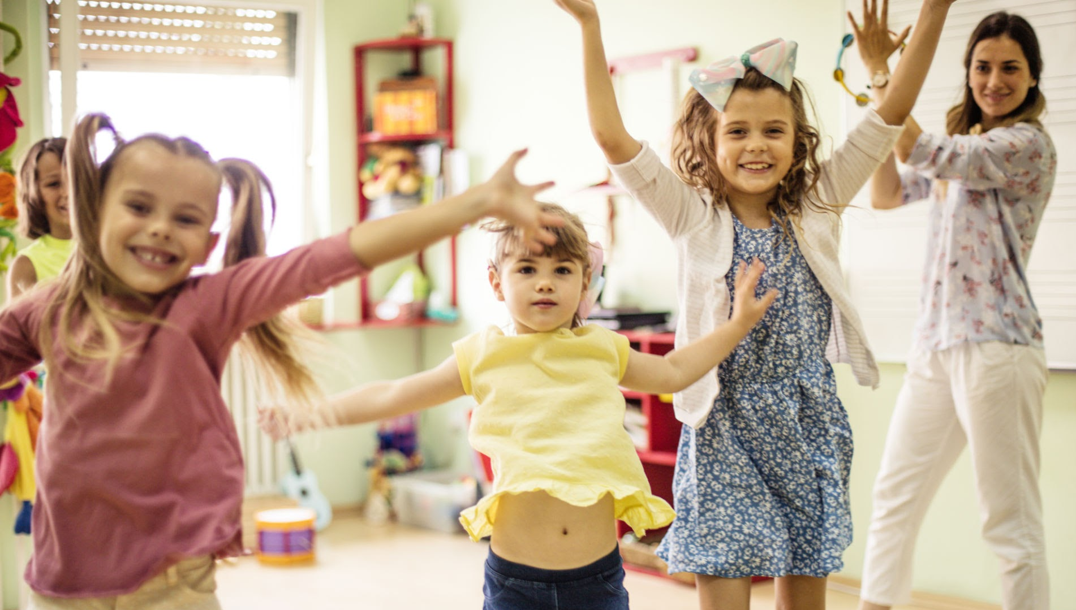
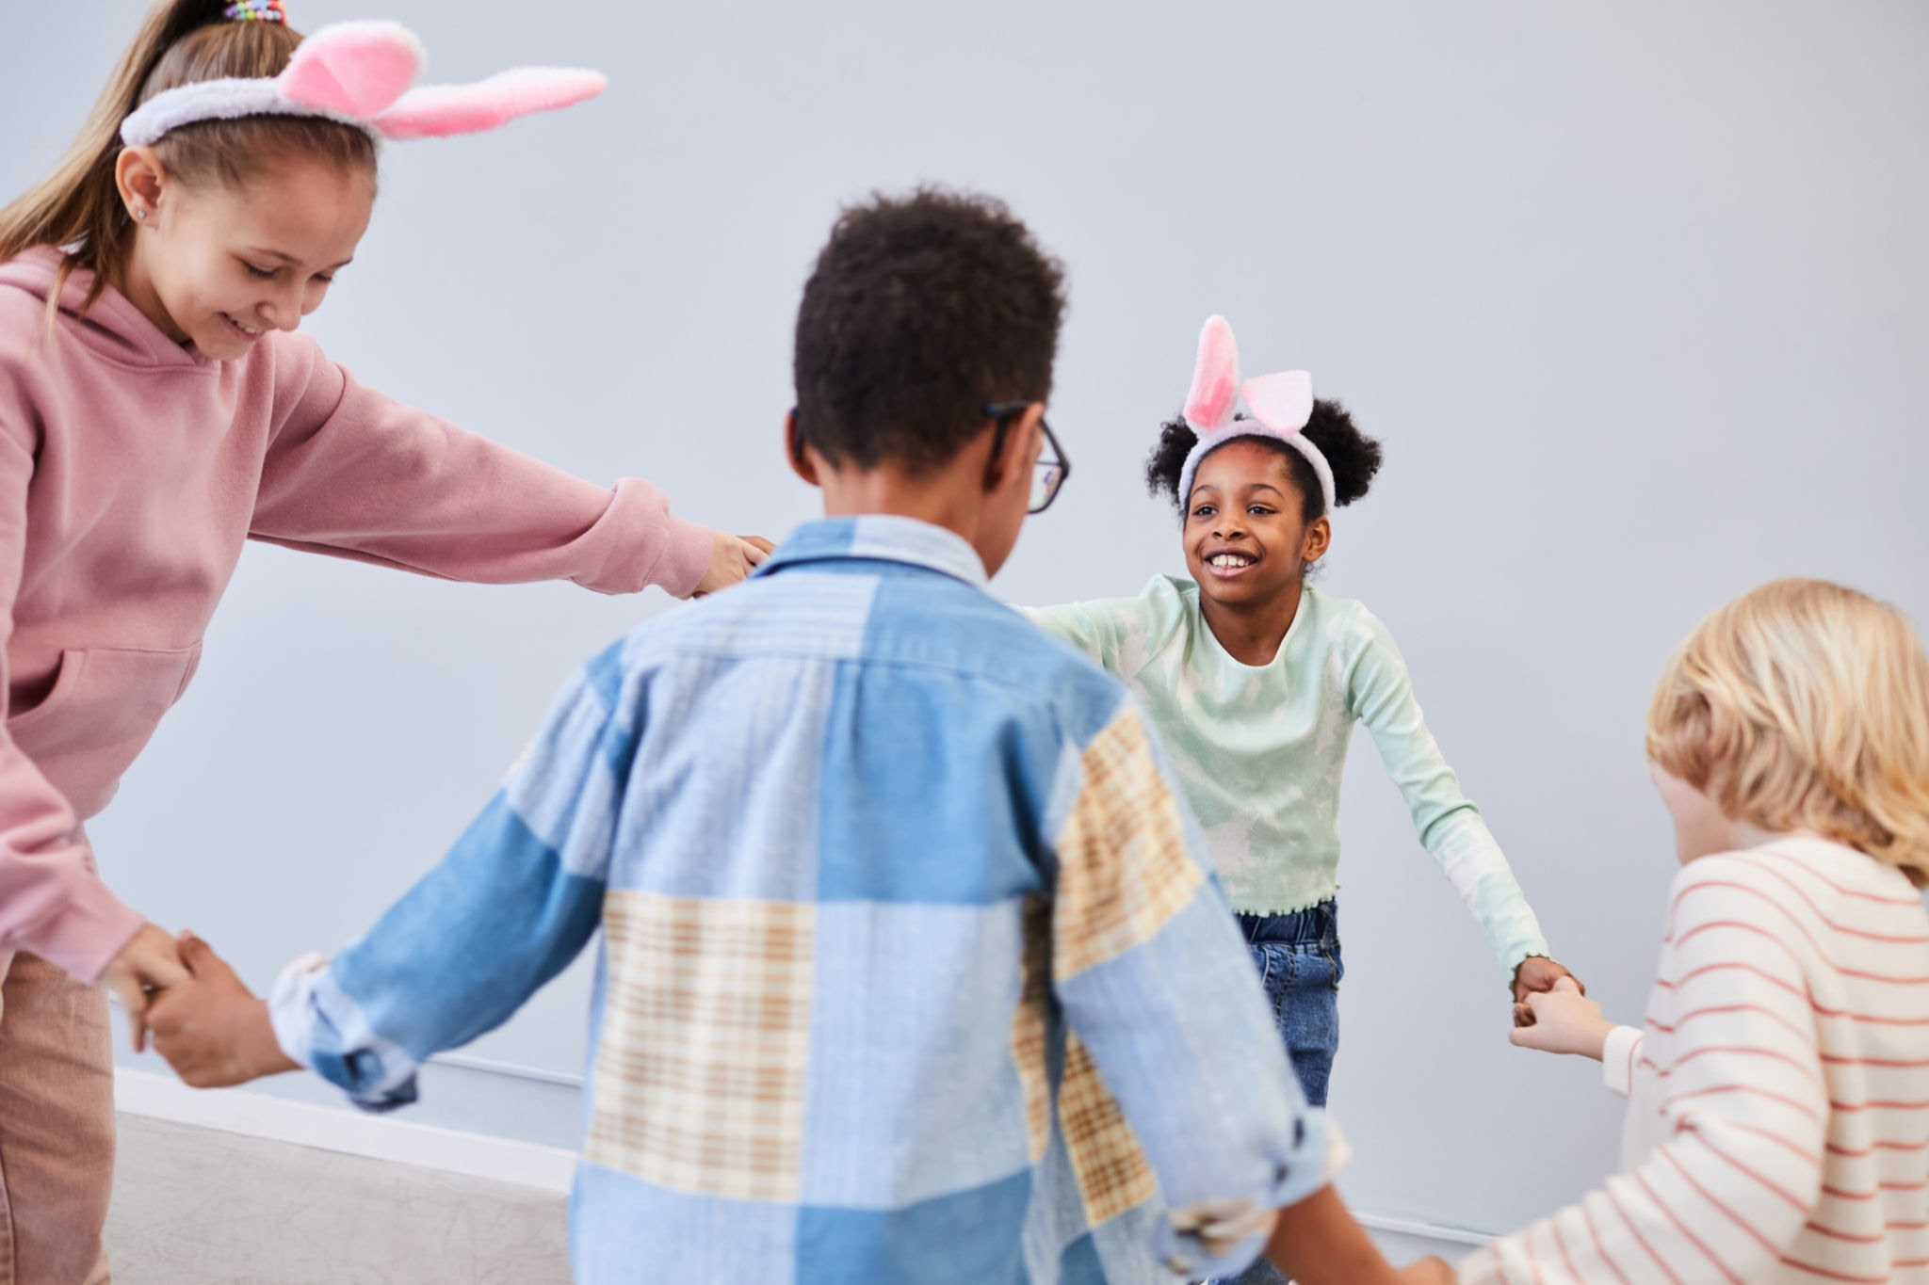
For preschool classroom
At this age, children are capable of forming clearer speech and saying words and short sentences. This is also the same age when routine becomes essential for children, as it helps them have a schedule, which establishes healthy and constructive habits, and gives them confidence and independence. Using rhymes and different techniques while transitioning from one activity to another, or while greeting and saying goodbye, makes it easier for the child to settle in and develop familiarity with what is next. We can use techniques such as tapping, dancing, and clapping while singing songs such as ‘We Welcome You!’ and ‘Busy Bee’.

Slide 10
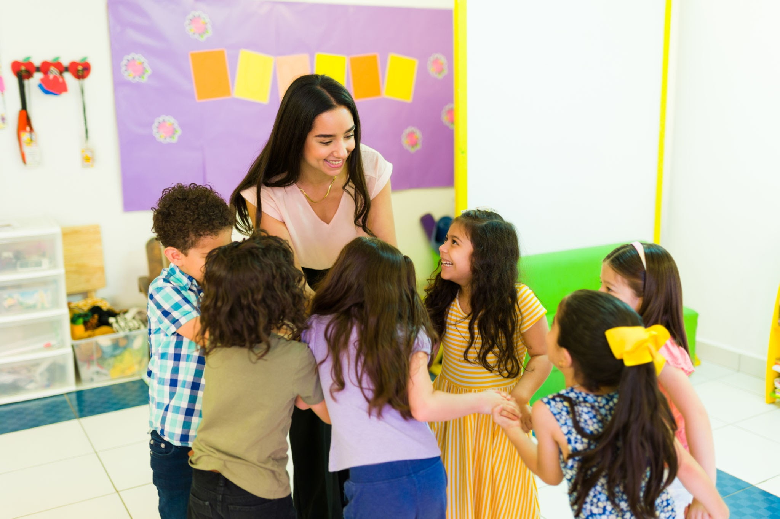
We Welcome you!
We welcome you to school today,
School today, School today,
We welcome you to school today,
Please come in and play.
We’re glad to have you here today,
Here today, here today.
We’re glad to have you here today.
Yes, it’s a special day!
(Song will be uploaded separately on website)

Slide 11
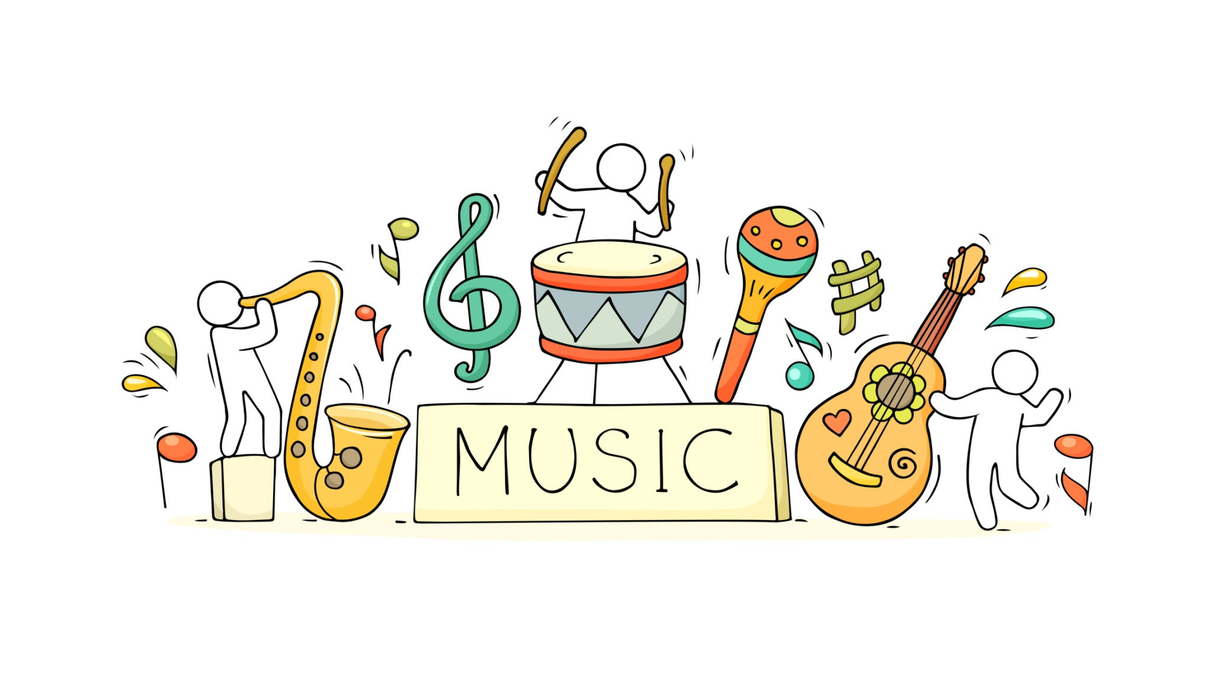
Music Time Is Here!
Sing, sing, sing with me
Sing out loud and clear
To tell the children everywhere
That music time is here
(and repeat again)
(Song will be uploaded separately on website)

Slide 12
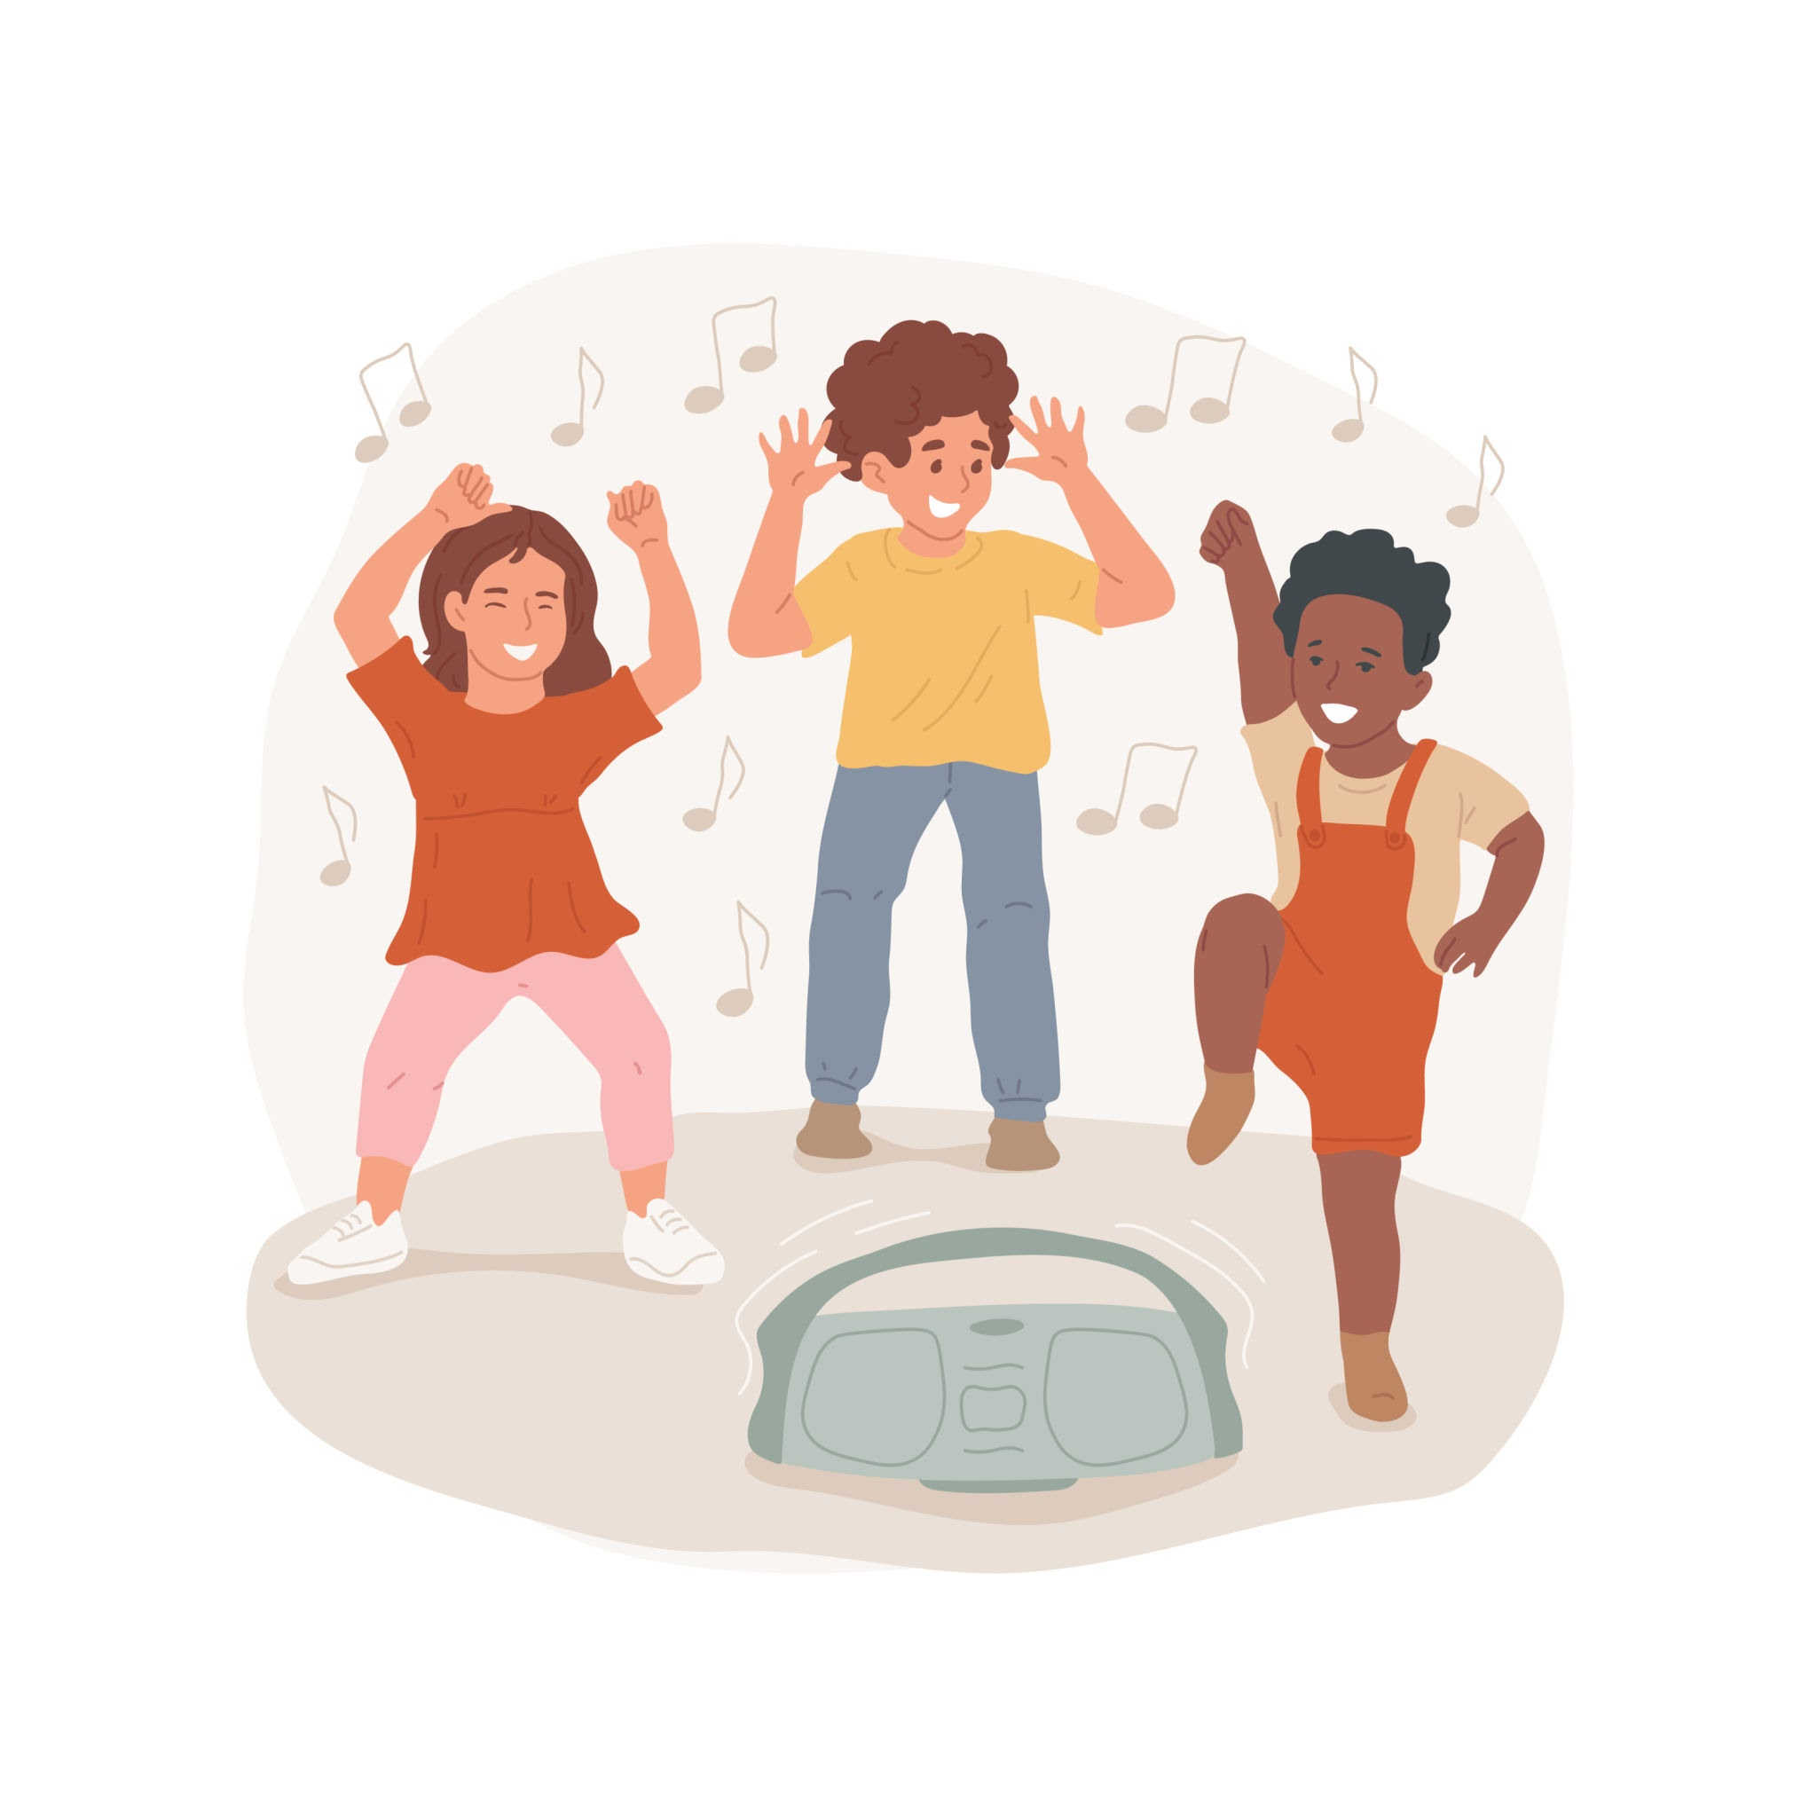
Final note
Music and movement are essential for child development, creativity, and enjoyable learning. Through intentional use, parents and educators can create environments that encourage holistic growth in children and make learning engaging.

