Slide 1
Assignment - 7
There are several techniques used to incorporate music in infant and toddler (0 - 3 years). These methods are designed to engage young children through sensory and physical activities, promoting development in a fun and interactive way.
1)Bounces: Gently bouncing a baby on your lap or knee to the rhythm of music.
2)Wiggles: Encouraging a child to wiggle their body, hands, or feet to the music.
3)Tickles: Lightly tickling a child to the beat of a song.
4)Finger Play: Using fingers to act out a story or song, often with rhymes.
5)Tapping: Tapping on a surface, a body part, or a simple instrument to the rhythm.
6)Clapping: Clapping hands together to the beat of the music.

Slide 2
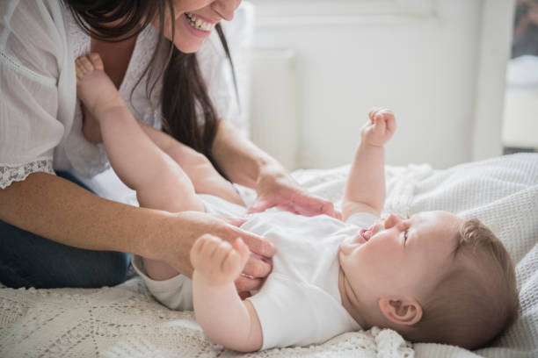
Animal Tickle Parade:
Age Group - Infants / Toddlers (0 -3 years)
Learning Objectives: To promote bonding and emotional connection between caregiver and child.
To develop listening and responding skills.
To help children recognize animals and their sounds.
To encourage body awareness through gentle touch and play.
Rhyme
Here comes a bunny, hop, hop, hop,
He stops by your tummy— tickle, tickle— stop!
Here comes a kitten, soft and sweet,
Tickle, tickle, tickle — on your little feet!
Here comes a puppy, wagging his tail,
He’ll tickle your nose — without fail!
Here comes a bear, big and round,
Tickle, tickle, tickle—till giggles abound!

Slide 3
There are four techniques for incorporating music into a preschool classroom for children aged 3-5 years. These techniques are designed to engage young children and develop their musical skills.
1) Voice exploration: This involves encouraging children to experiment with different sounds their voices can make, such as whispering, singing loudly, making high and low sounds, and imitating animal noises. This helps them understand and control their vocal cords.
2)Pitch matching songs: This technique uses simple songs to help children learn to match the pitch of a melody. Examples include songs with repetitive phrases and a limited range of notes, which helps them develop their aural skills.
3)Adding movement to rhyme: This involves combining simple rhymes or songs with physical actions. This helps children connect language and rhythm with body movements, improving their coordination and memory.
Example Rhyme: "Head, Shoulders, Knees, and Toes" is a classic example. Children touch each body part as it is mentioned in the rhyme.
4)Steady beat games: These games focus on helping children identify and maintain a steady beat. This can be done by clapping, tapping, or marching to a consistent rhythm, which is a foundational skill for musical development.

Slide 4
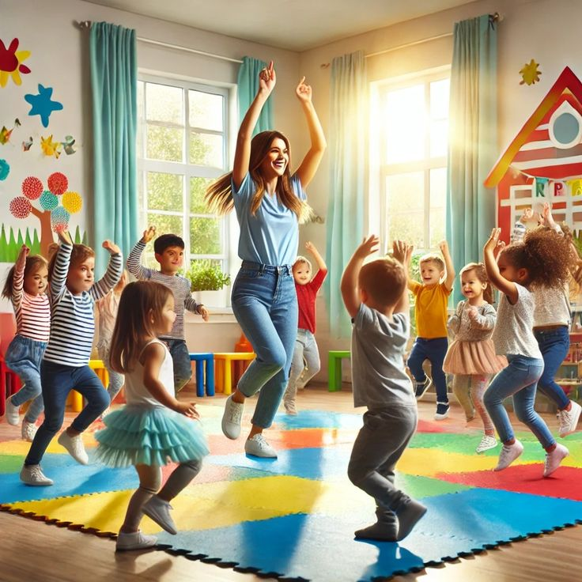
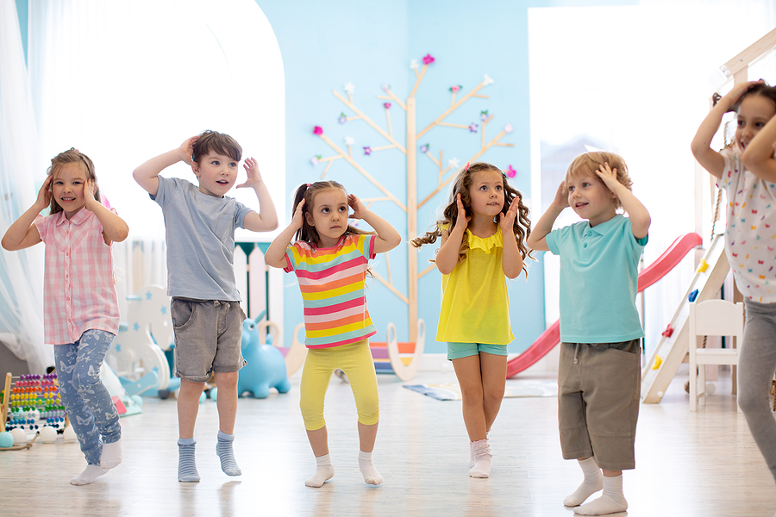
The Movement Rhyme
Learning objective - To enhance balance, flexibility and co-ordination through movements
To enjoy group participation and express themselves through movements
To build rhythm, rhyme awareness, and vocabulary through chanting.
Rhyme
Up, up, up! Stretch so high,
Like an airplane in the sky!
Down, down, down! Touch your toes,
That's as low as your body goes
Forward marching - one, two, three,
Backward marching, follow me!
Give a wiggle, give a shake,
A fun new rhyme is what we make.

