Slide 1
ECEP Assignment 2
Plan an activity for each domain of development in detail (Age 3 to 4 years). Support it with picture.
Cognitive (Reasoning & Thinking)
Physical ( Use of Big & Small Muscle)
Language (Oral & Written)
Socio - Emotional (Manage Emotions & interact with others)

Slide 2
COGNITIVE (Reasoning & Logical Thinking)
Name: “Sort the Beans”
Objective: To enhance categorization skills, problem - solving & critical thinking
Materials:
2 Bowls
Kidney Beans
Chickpea
Process:
Put down the mixed beans and chickpeas in front of the child
Give the child 2 different coloured bowls
Ask the child to then separate the chickpeas and kidney beans in their respective bowls

Slide 3
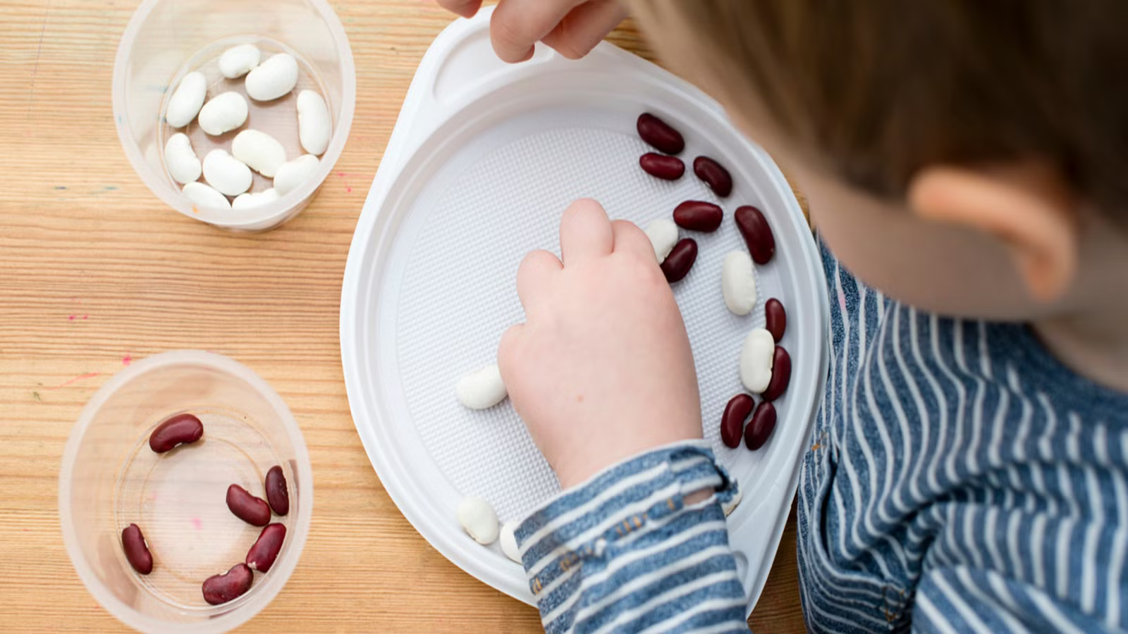
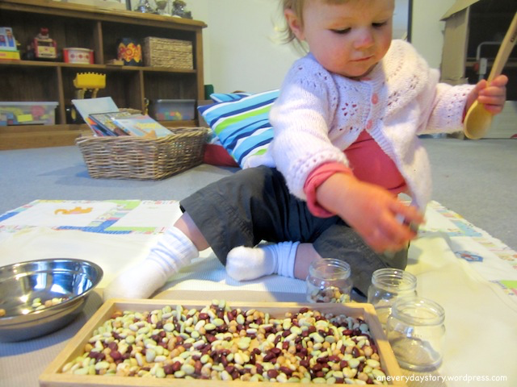
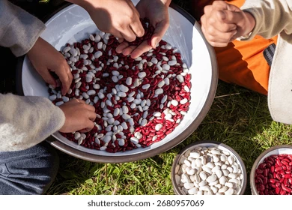
COGNITIVE (Reasoning & Logical Thinking)

Slide 4
PHYSICAL (Use of Big & Small Muscles)
Name: “Building Block Hop Challenge”
Objective: To enhance the fine and gross motor skills of a 3 year old child
Materials:
Coloured tape
Building blocks
Process:
Before the children come into the classroom, the teacher keeps a template of 2 shapes eg: Square and Triangle with the help of coloured tape on the ground
Let the children arrange the blocks on the template and create the shape. (Fine Motor)
After the shapes are ready, ask the children to jump in & out of the shape with touching or breaking the shape. (Gross Motor)

Slide 5
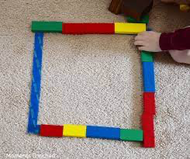
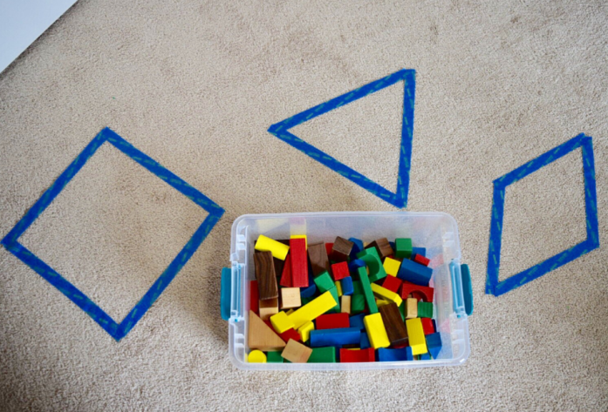
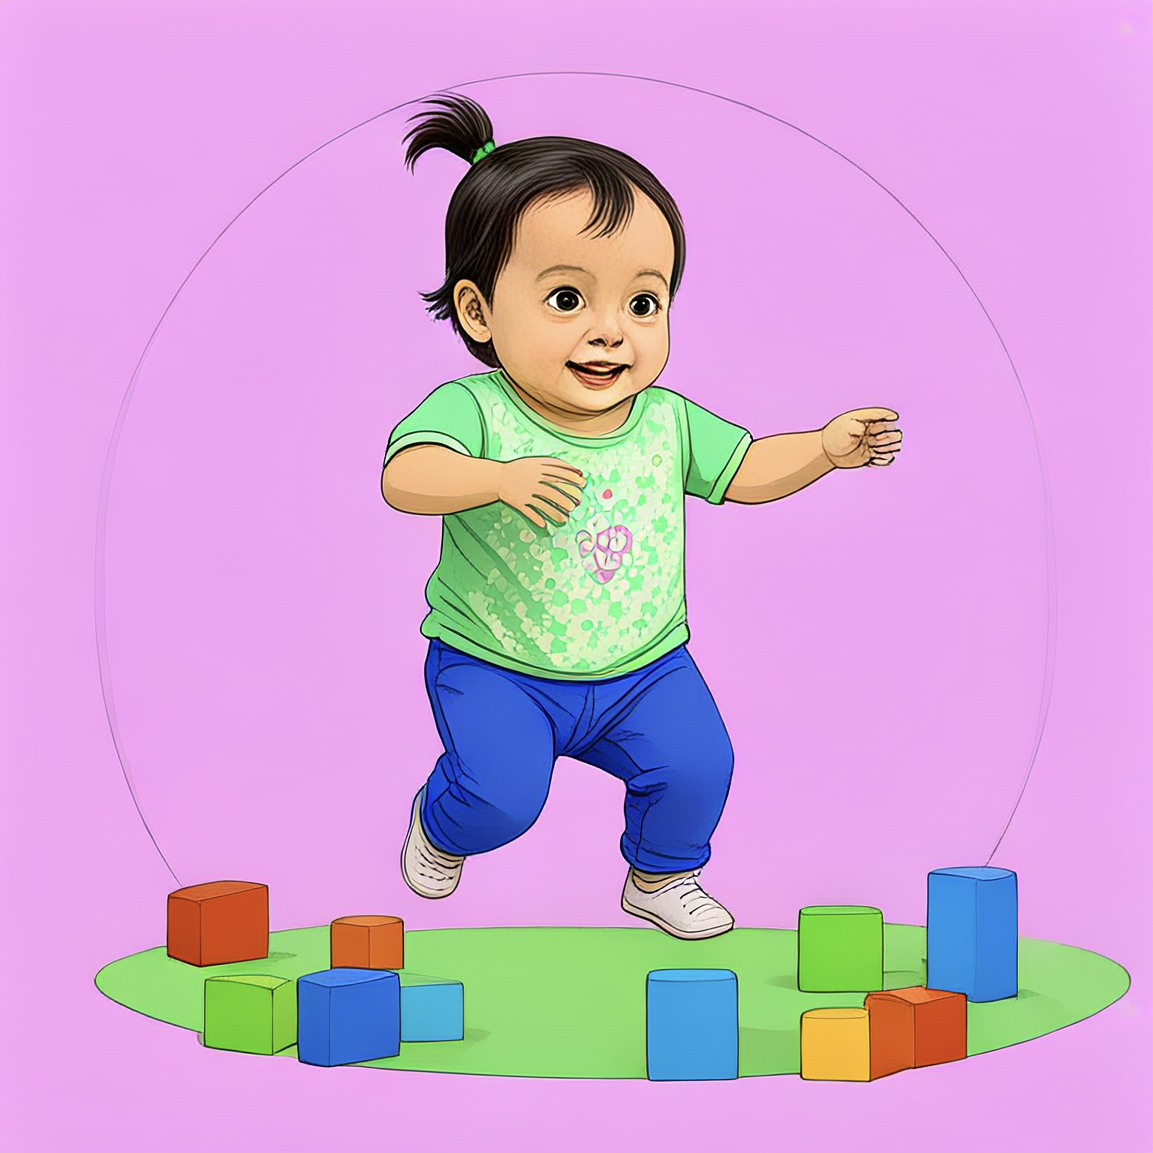
PHYSICAL (Use of Big & Small Muscles)

Slide 6
LANGUAGE (Oral and Written Skills)
Name: “The Mystery Box”
Objective: To identify and name familiar objects & understand simple words and short sentences
Materials:
A small box
3-4 real life, familiar objects like - ball, spoon, teddy bear
Process:
Show the bag to the children and build a sense of excitement to find out what is inside the bag
Give each child an opportunity to put their hand in the bag and feel one object without looking and ask them if they can guess what object it is
Once the child takes out the object, ask them simple questions like - “What is it?” What is the colour of the object?” “What do we do with it?”
After they answer the questions in short sentences, use songs that have these objects in order to enhance their speaking and vocabulary.

Slide 7
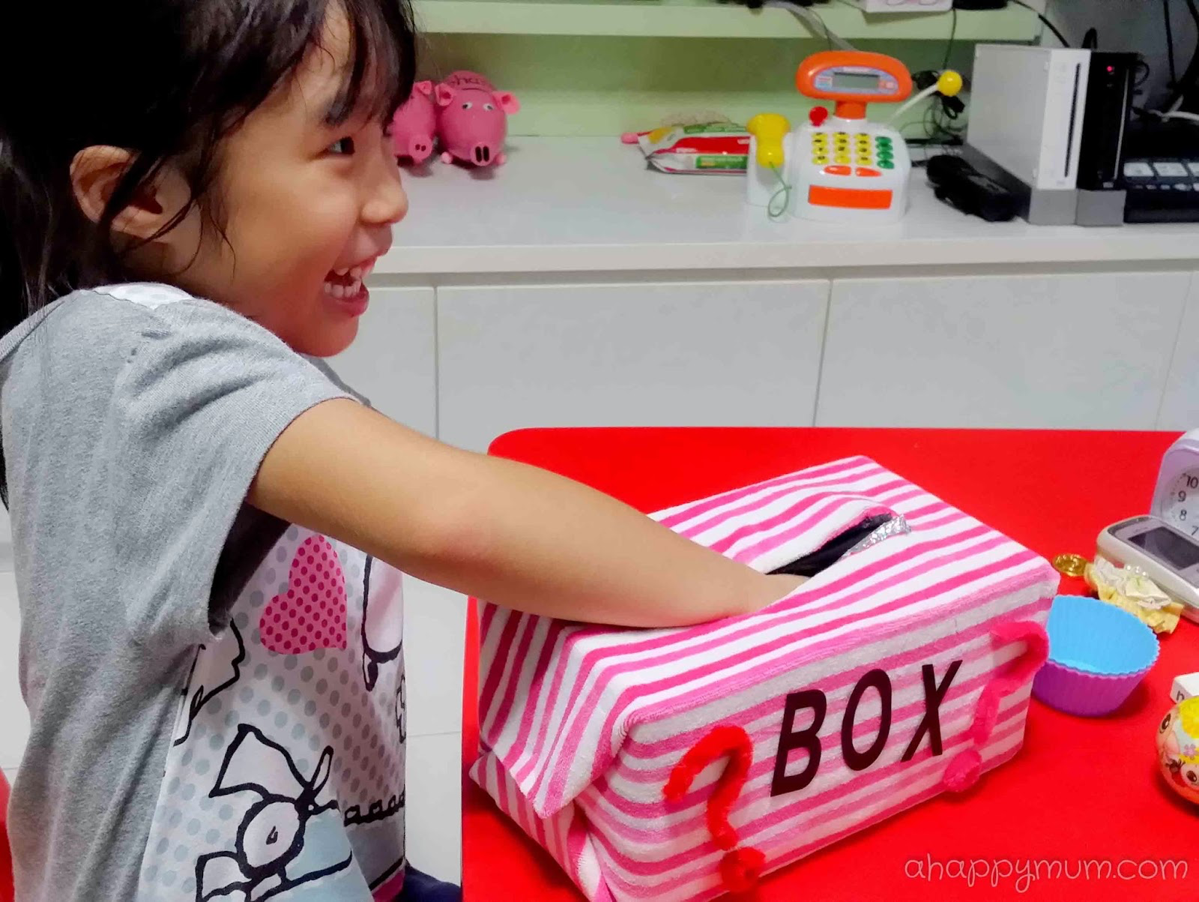
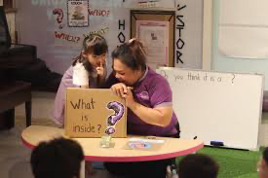
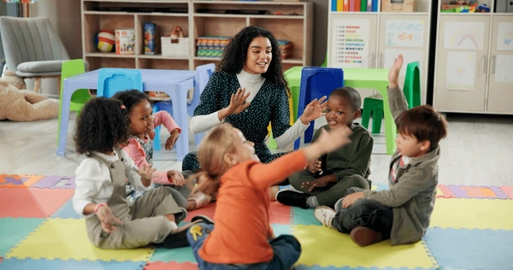
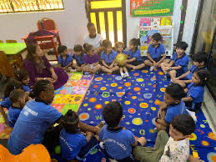
LANGUAGE (Oral and Written Skills)

Slide 8
SOCIO - EMOTIONAL (Manage Emotions & Interaction with Others)
Name: “Sharing is Caring”
Objective: To practice sharing & taking turns, developing empathy
Materials:
A soft ball
Music (Optional)
Process:
The children are made to sit in a circle with the teacher holding the ball.
The teachers demonstrates the activity by saying “I have the ball now. I shall share it with my friend Adya” handing over the ball to the child named Adya next to her with a smile.
Encourage the child to take their friends name while sharing and the child receiving the ball, receives the same with “Thank you” and then passes it forward
You can add music and say when the music stops, the child that has the ball, holds it and says something nice to the group.

Slide 9
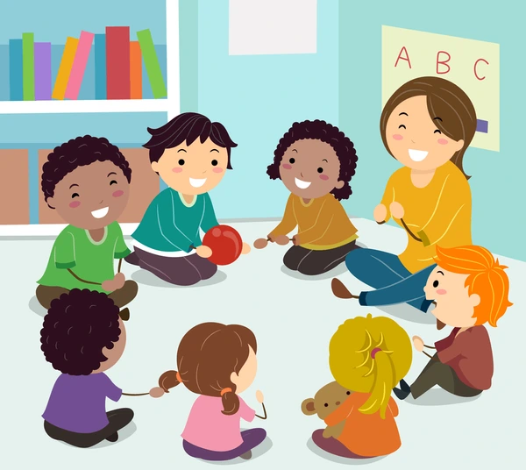

SOCIO - EMOTIONAL (Manage Emotions & Interaction with Others)

