Slide 1
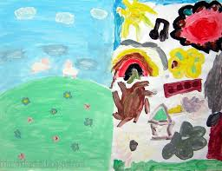
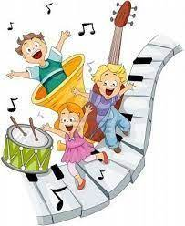
Motor skills :
Playing with musical instrument and holding brush for painting its help them to improv motor skills & coordination
Creativity :
Children start creating their own imagination through music and art. They explore new color and sound.
Emotional Development:
Its help children to express their emotions in healthy way.
Art & Music
Cognitive Skills:
Art & Music help children to learn problem solving and make decision.
Nilima Alex

Slide 2
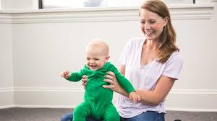
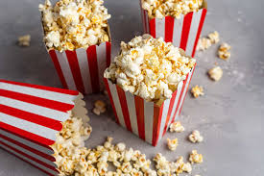
Music in the Infant and Toddler class room ( Birth to 3 Years )
Bouncy Rhythm
Popcorn, popcorn, Sizzling in the pan.
Shake it up, shake it up, Bam, bam, bam!
Popcorn, popcorn,
Now it’s getting hot, Shake it up, shake it up, Pop, pop, pop!

Slide 3
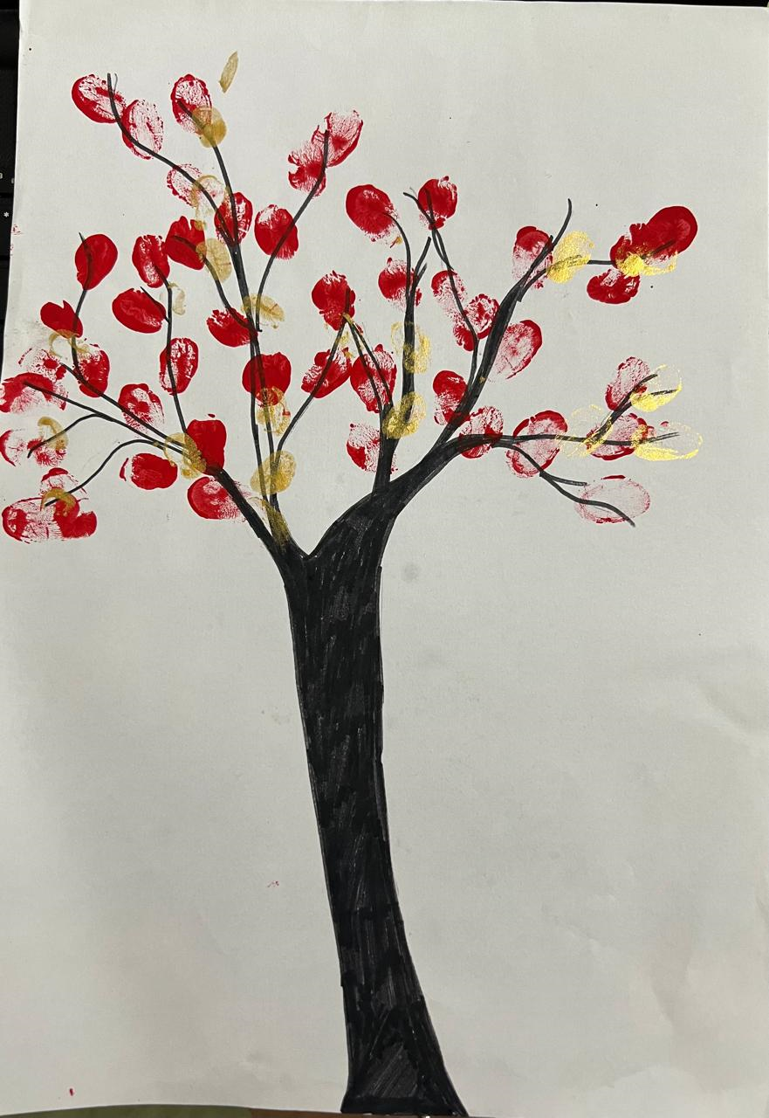
Art ( 4 to 5 years )
Fine motor skills: Finger Painting helps children to learn and develop their senses.
Color texture, smoothness, cool, and experiment with colour and patterns. Its increase to develop their creativity

Slide 4
Popcorn: Baby Knee Bounce Rhyme
https://youtu.be/ixLxQZ8EAas?si=AkMkkpj5Ml_bH6Td

