Slide 1
Phonics & Foundational Literacy

Slide 2
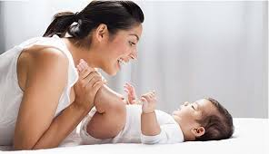
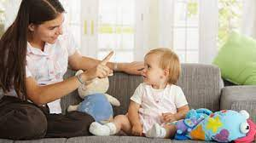
Age Group 0 - 1Y:
ACTIVITY: NARRATING DAILY ACTIVITIES
MATERIALS NEEDED: Nothing specific, keep talking to babies about daily activities and also about everything they see around in nature.
DESCRIPTION: Describe daily activities as you go about them, such as mealtime, bath time, and bedtime. This helps children associate words with actions and objects. For e.g:
Morning: Waking Up: "Good morning, baby! Let's get ready for the day. We'll wash your face and brush your teeth."
Mid-morning: Playtime: "Look at all the toys! Let's play with the ball and blocks. Can you find the cat?"
Late Morning: Naptime Routine: "Time for a nap. Let's read a story and cuddle up for some sleep."
Afternoon: Exploration Time: "Let's go for a walk and listen to the birds chirping. Look at the dogs wagging their tails!"
Evening: Bath Time: "Splash, splash in the water! Bath time is fun. Let's wash your hands and feet."
Bedtime Routine: "Time to get cozy in your bed. Let's read a book about stars and moon."
Make sure to use a warm and engaging tone to keep the interactions enjoyable for both you and your little one.
OBJECTIVE: The objective of literacy activities for children below 1 year old is primarily to foster a positive environment for language development and early literacy skills. While infants may not yet be able to read or comprehend.

Slide 3
Age Group 1 - 2Y:
ACTIVITY: READING TOGETHER
MATERIALS NEEDED: Board books with big, colorful illustrations and simple repetitive text and Touch and Feel Books.
DESCRIPTION: Introduce board books with simple, colorful pictures and few words. Even though they can't understand the words yet, babies enjoy hearing the rhythm of your voice and looking at the pictures. Opt for touch-and-feel books with different textures for them to explore with their hands. Point to and name objects in the pictures to help build vocabulary. Read short, simple stories aloud to your child.
OBJECTIVE: The objective of touch and feel books activity for kids is to stimulate their senses by providing textures and materials for them to explore through touch. This activity encourages sensory development, language skills, and cognitive abilities as children engage with different textures, describe what they feel, and make connections between the textures and real-world objects or concepts. It also fosters creativity, curiosity, and a love for reading at an early age.

Slide 4
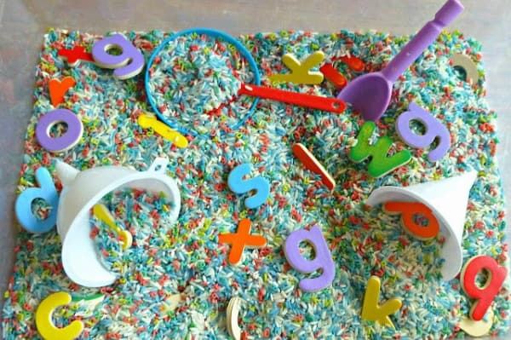
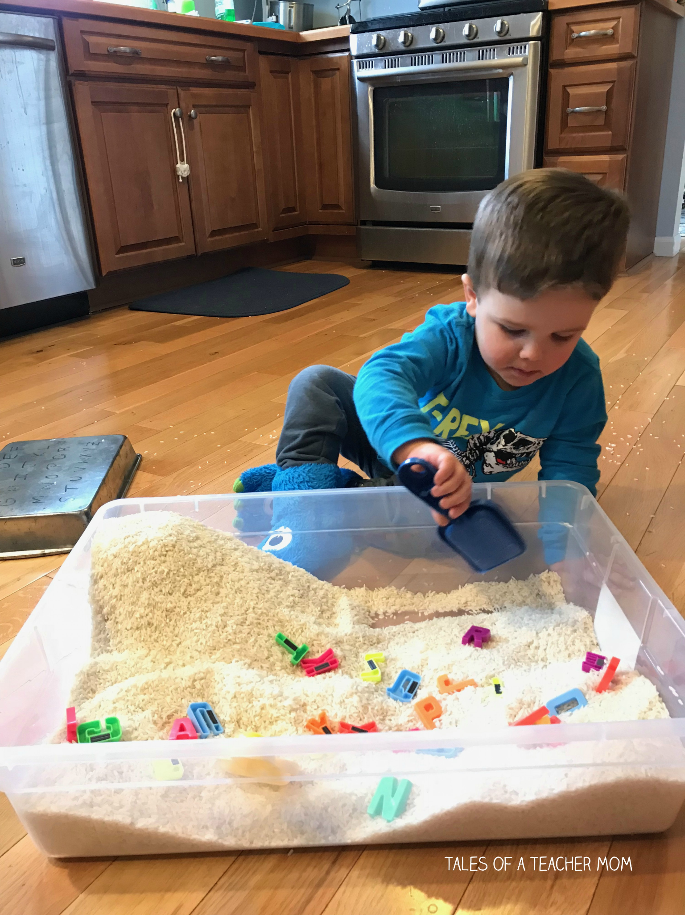
Age Group 2 - 3Y:
ACTIVITY: SENSORY PLAY WITH LETTERS
MATERIALS NEEDED: Use large bin, rice, dry beans, or shredded paper, tactile materials like foam letters, magnetic letters, or textured flashcards to introduce letters.
DESCRIPTION: Prepare the Sensory Bin: Fill the large plastic bin or container with rice, dry beans, or shredded paper to create a tactile sensory experience for toddlers. Ensure that the filling material is safe and appropriate for their age.
Add Foam or Magnetic Letters Scatter foam or magnetic letter throughout the sensory bin, burying them slightly beneath the surface. Mix them up to make the hunt more challenging.
Sit with the toddler and explain that they will go on an "Alphabet Hunt" to find and match letters. Show them a few examples of letters and say their names to familiarize them with the task. Encourage the toddler to use their hands to search through the sensory bin, feeling the texture of the filling material as they hunt for letters.
OBJECTIVE: Through this sensory bin activity, toddlers will develop letter recognition skills, tactile sensory exploration, and fine motor coordination. Additionally, the interactive and hands-on nature of the activity fosters engagement and enjoyment in the learning process.

Slide 5
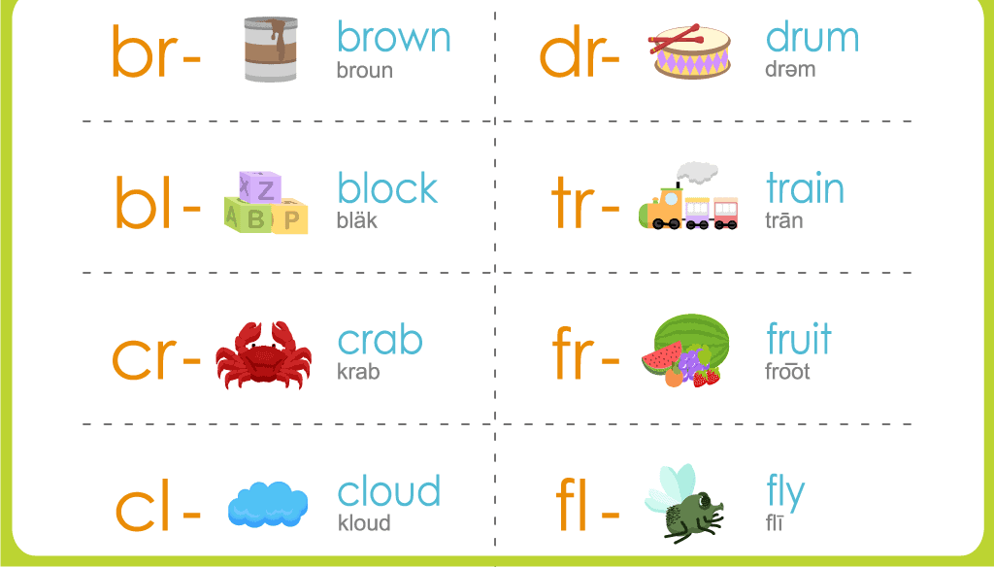
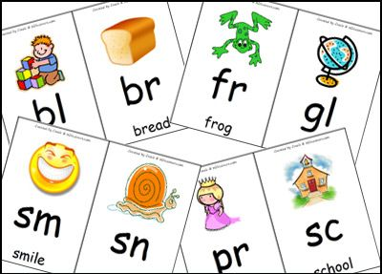
Age Group 3 - 4Y
ACTIVITY: VISUAL AID FOR BLENDS
MATERIALS NEEDED: Flashcards or small cards with words containing blends (e.g., bl, br, cl, cr, etc.), large poster board or chart paper, marker, sticky notes or tape
DESCRIPTION: Start with Sounds: Begin by reinforcing the individual sounds of letters. Use flashcards, songs, or games to help children become familiar with the sounds each letter makes.
Introduce Blends: Once children are comfortable with letter sounds, introduce blends by emphasizing how two letters come together to create a sound retaining its individual sounds. Start with simple blends like "bl," "cl," "cr," "st," etc. Include colorful pictures of words that start or end with the target blend to provide context and make learning more engaging. Provide plenty of opportunities for children to practice identifying and saying words with blends.
OBJECTIVE: This activity aims to help students recognize and identify blends within words, improving their reading and phonics skills in a fun and interactive way.

Slide 6
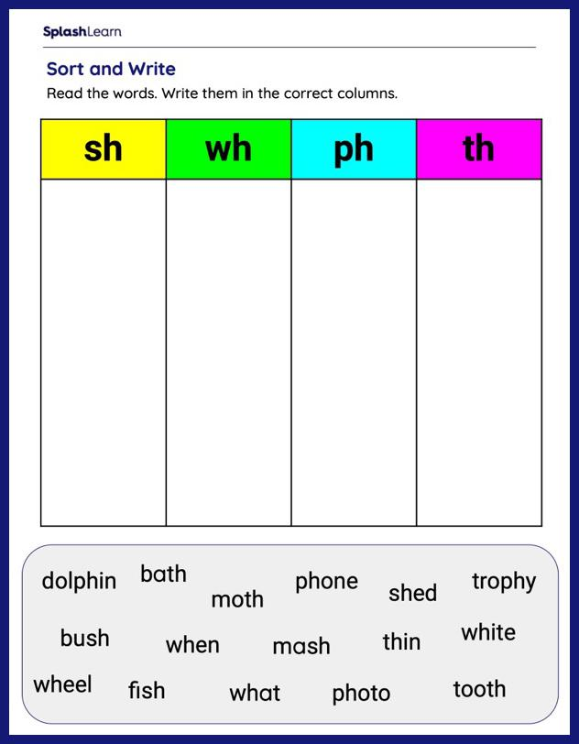
Age Group 4 - 5Y:
ACTIVITY: DIGRAPH DETECTIVE
MATERIALS NEEDED: Picture cards or objects representing words with various digraphs (e.g., "sh," "ch," "th," "wh"). Flashcards, printed images, or small toys., large sorting mat or divided tray labeled with each digraph category (e.g., "sh," "ch," "th," "wh"), marker or labels to mark each section of the sorting mat or tray.
Optional: Magnifying glass or detective hat for added fun.
DESCRIPTION: Explain to the children that they are going to become "Digraph Detectives" and solve the mystery of sorting words with different digraphs. Show them the sorting mat or tray and explain how each section represents a different digraph.
Review the digraphs with the children, emphasizing the sound each digraph makes. You can provide examples of words containing each digraph to reinforce their understanding.
Spread out the picture cards or objects representing words with digraphs on a flat surface. Invite the children to examine each card closely and determine which digraph it contains.
Encourage the children to pick up each card and place it in the corresponding section of the sorting mat or tray based on the digraph they hear in the word. They can use the magnifying glass or wear the detective hat for added excitement.
OBJECTIVE: The objective of this digraph sorting activity is to help children practice identifying and categorizing words with different digraphs while enhancing their visual discrimination skills and phonemic awareness.

Slide 7
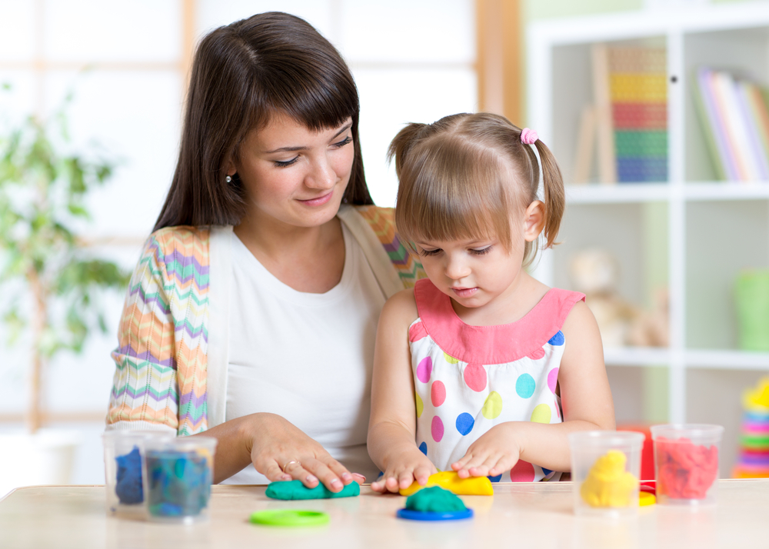
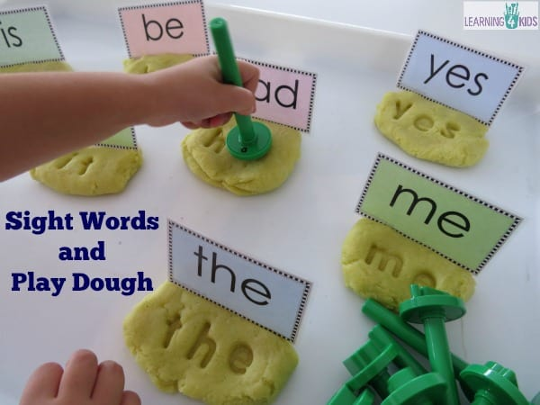
Age Group 5 - 6Y:
ACTIVITY: SIGHT WORDS ON PLAY DOUGH
MATERIALS NEEDED: Play dough in various colors, sight word flashcards or a list of sight words
DESCRIPTION: Show the child the sight word on a flashcard or verbally tell them the word.
Encourage the child to roll out the play dough into long strips or flatten it with their hands on a flat surface.
Then, ask the child to shape the play dough into the letters of the sight word. They can mold the play dough by pinching, rolling, and shaping it into the correct letter forms.
Once the child has formed the sight word with the play dough, encourage them to say the word aloud.
You can also extend the activity by asking the child to use different colors of play dough for each letter of the sight word or to create additional sight words.
Repeat the process with different sight words, allowing the child to practice forming and recognizing a variety of words.
OBJECTIVE: This activity engages multiple senses (sight and touch) to reinforce sight word recognition and spelling in a hands-on and enjoyable way. It encourages fine motor skills development while making learning fun and interactive.

