Slide 1
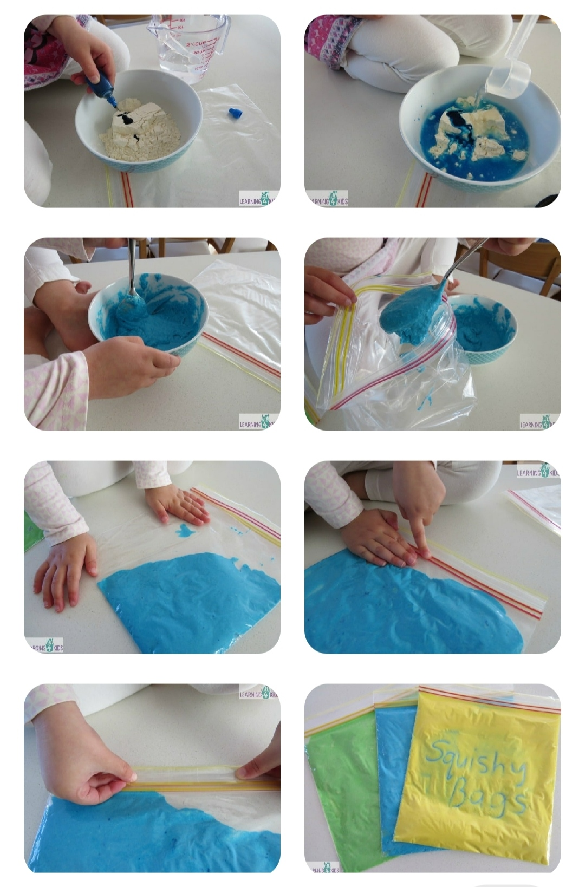
Introduction of “a” for 0 to 2 years Sensory bag activity

Slide 2
Materials needed : Zip-lock bag, flour, water, food colour, sticky tape,small mixing bowl and a spoon.
How to make squishy sensory bag : There are so many different ways to make squishy bags. Can prepare using glue, paint, hair gel, baby oil and creams. But will see here using flour,water and food colour. Place the flour into a small bowl. Then add food colouring and water. Mix until all the ingredients are well blended. Scoop the flour mixture into the plastic zip-lock bag. Before fastening the end,place the squishy bag onto a flat surface.Gently push any excess air out to avoid air bubbles. Press the clips of the bag closed and ensure there are no holes. Place sticky tape along the opening to secure the opening. Adjust the flour and water amounts depends upon the size of zip-lock bag.
Description : First facilitator has to introduce the “a” phonic sound by showing the flash cards which written by little letter “a” in big size. Then show the pictures or objects which starts with the phonic sound of “a” like an apple, ant,.. Let the kids to touch and feel the object. After finishing the introduction, children can do the activity. For that facilitator has to prepared the sensory bags as earlier itself. Arrange the kids to sit on chairs or floor. Give the sensory bags to each and everyone. First let the kids to touch and feel. Let them to write anything as their wish. Then one by one help the kids to write as “a” by holding their hands. Explore them the colour of the bag. Ask them whether its soft or hard. This activity helps for the small muscles development and by continuous practice they can identify the letter “a” and its sound.

Slide 3
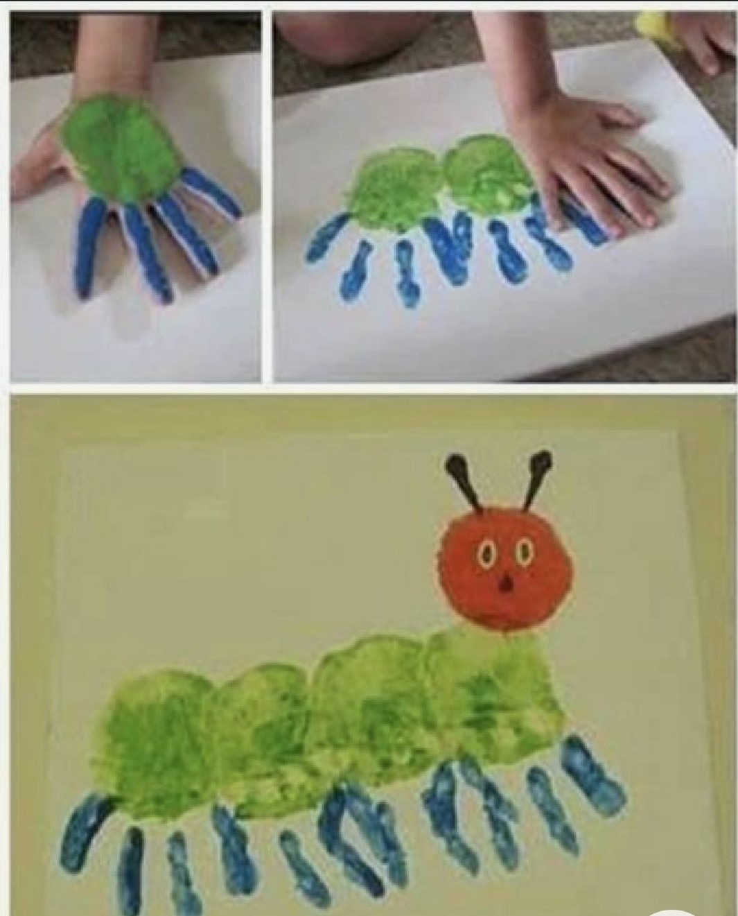
Revision of “s” and “a” for 2 to 3 years Handprint activity

Slide 4
Materials needed : A4 size charts in different colours, different colour of paints,buds, sketches and whitener.
Description : while doing the revision facilitator has to recall the phonic sounds of “s” and “a” by showing the pictures or objects. In that objects, select any one for the handprint painting like “s” refers sunshine and “a” refers ants. Before starting the activity facilitator has to ensure that all the things are ready for the activity. First arrange the kids to sit on chairs properly. Give the A4 size charts to everyone then ask the kids who are all wants to make an ants and who are all wants to make a sunshine and segregate them. Spread yellow paint in kids hands those who are ready to do sunshine and spread double colour for body and legs those who are ready to do ants and show the sample also by printing one hand in both. Help the children for printing their hands to make as sunshine and ants. Again recall the sounds. Explore the colours. Explore about the weather of sunny. Finally facilitator has to complete the activity by painting the face using buds. Use whitener to draw an eyes. Then nose and mouth using sketches. Let it dry for few minutes and ask the kids to touch the eyes,nose and mouth to explore about it. Facilitator has to use this as a takeaway activity.

Slide 5
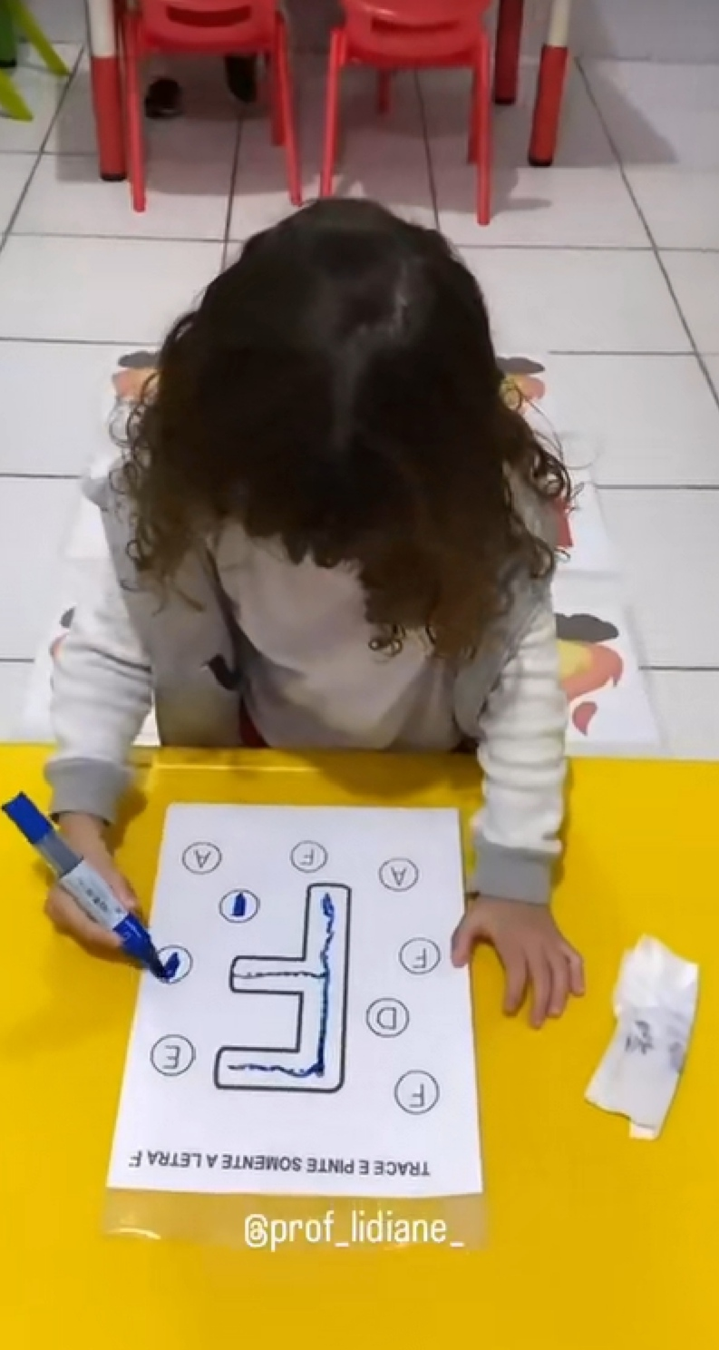
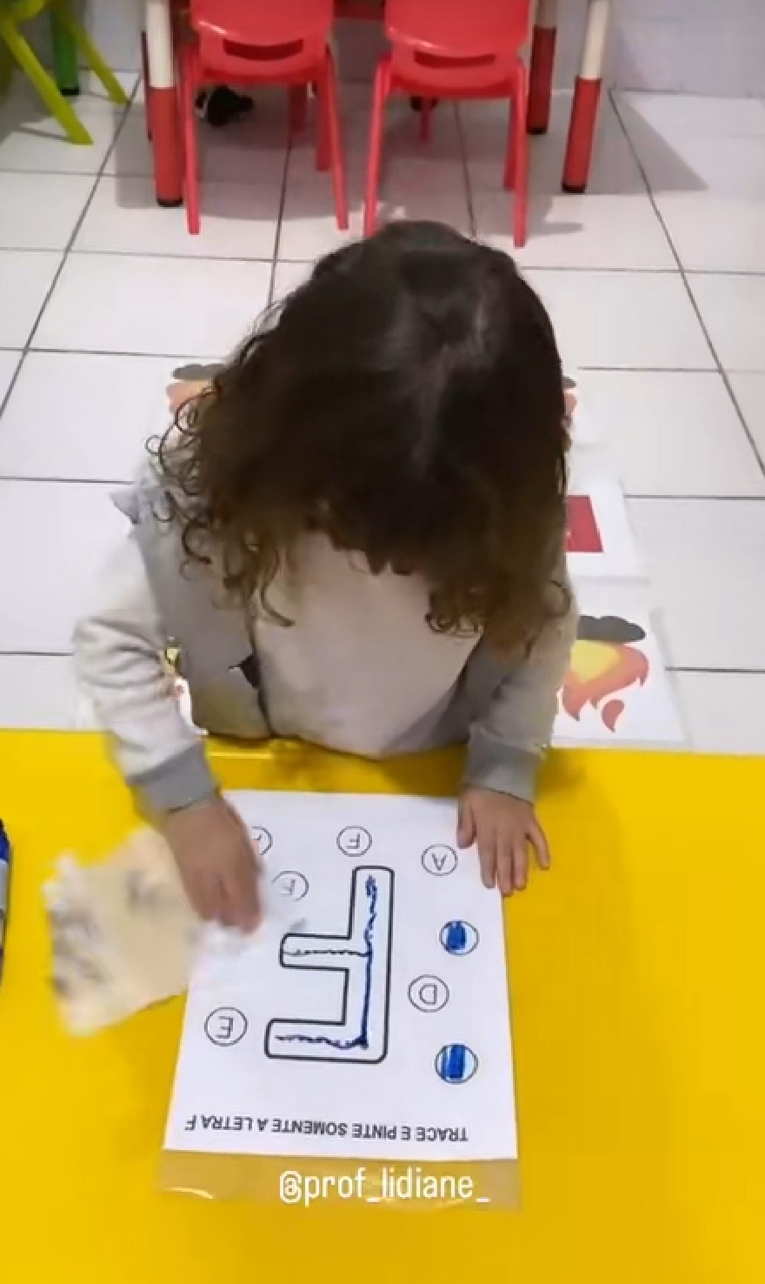
Revision of “F” for 3 to 4 years Gross and Fine motor activity

Slide 6
Materials needed : Printouts as written by F and picture of fire, fevicol, worksheet, cello tape, sketch and wet wipes.
Description : First facilitator has to make the arrangements for this activity by sticking the F and fire printouts alternatively on the floor. And stick the worksheets using tape on table then keep the sketch and wet wipes nearby the worksheet itself. For this activity children have to jump on the letter of F then they have to do the tracing and coloring on the worksheets afterthat they need to wipe it for the next child’s turn. Once teacher has to do the activity for clear understanding. Now facilitator has to call one by one to do the activity. Children has to wait for their turn through this social development skill may develop. By jumping on the letter, their physical body movements happen. By tracing, small muscle developments happen and by identifying the letter and doing the colouring, can see their cognitive development. From this activity they can recall the letter and its sound. So this is the activity for both fine and gross motor development. We can do this activity for all alphabets by changing the letters and pictures.

Slide 7
Revision of sight words for 4 to 5 years Sight words practice activity

Slide 8
Materials needed : Plastic or wooden spoons, bamboo pegs and sketches to write.
Description : Before starting the activity facilitator has to write the sight words on spoons using sketches and write the letters of that sight words in bamboo pegs. Then mix these all bamboo pegs and give to kids for arranging the correct letters into a correct sight word by sticking the bamboo pegs into the spoons. For example children has to stick t and o pegs into “to” written spoon. Through this activity they can recall the sight words. By opening and sticking the pegs into spoons, fine motor and cognitive skill may develops.

Slide 9
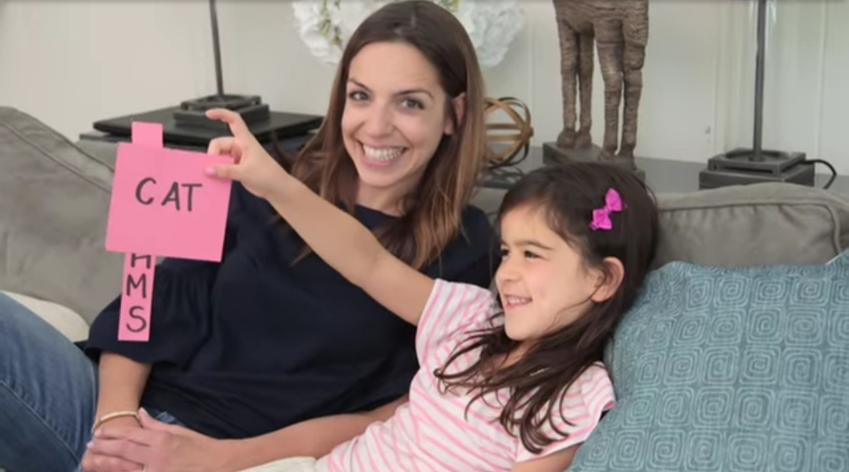
Revision of 3 letter words for 4 to 5 years. Word sliders activity

Slide 10
Materials needed : Chart, sketch and scissor.
Description : This is the activity of revision for 3 letter words which ended with “at” word. For that first facilitator has to cut the chart into a small piece in rectangle size then write “at”. Before “at” word need to cut the edges of square shape gap where can able to see one letter to make a three letter word. Then cut chart paper as one scale size lengthy. In that write the letters one by one as “ C,M,R,B and H. Now let the children to insert that lengthy chart paper into a gap of “at” before . Then let the kids to read along with that single letter with phonic sound. It turns into the three letter words such as Cat, Mat, Rat, Bat and Hat. we can follow the same activity for 4 letter words also which ended with “and” such as hand, sand,land,band,.. Through this activity children can learn and recall the words by moving the charts. Hand and eye coordination happen, small muscle movement and cognitive thinking also develops.
Thank you.

