Slide 1
Numeracy Activity

Slide 2
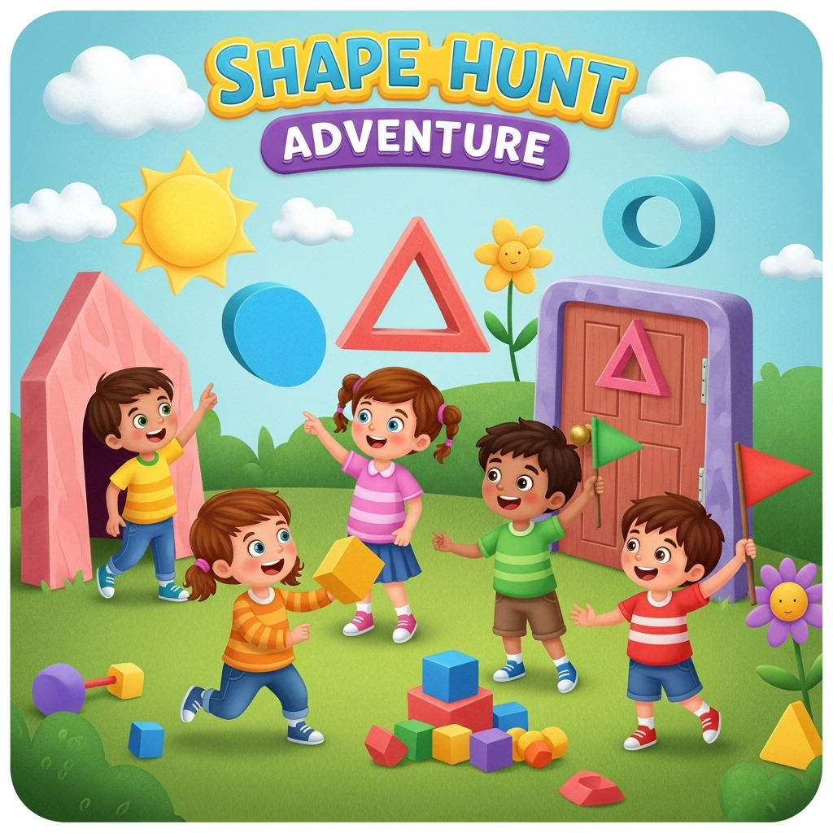
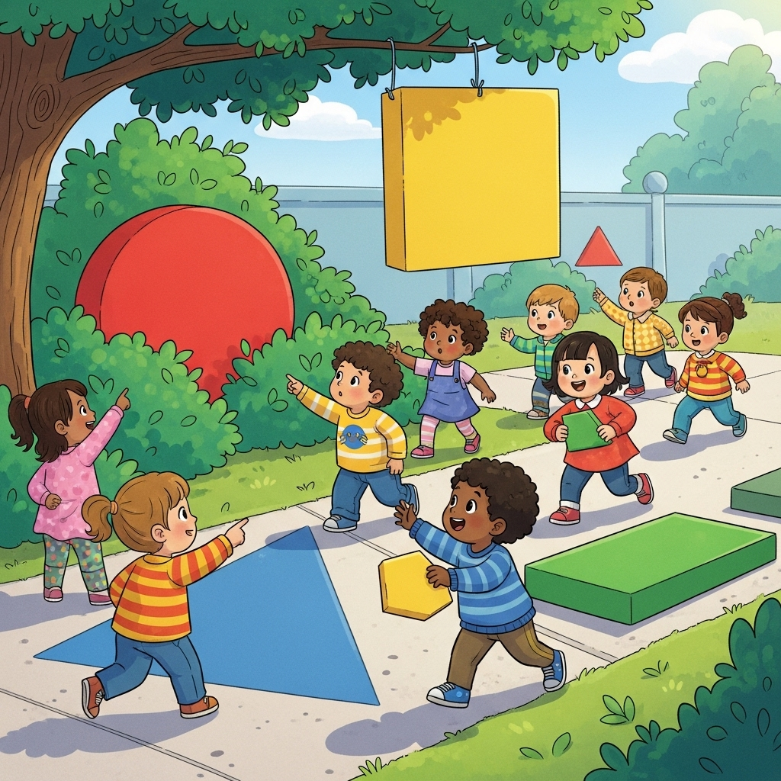
Age Group: 3–4 Years
Activity: “Shape Hunt Adventure”
Materials Needed:
Cut-outs of basic shapes (circle, square, triangle, rectangle) in cardboard or foam
A basket or bag
Chart with shape outlines
Learning Objective:
To help children recognize, identify, and name basic shapes.
To develop observation and sorting skills.
Description:
Place shape cut-outs around the classroom or play area.
Give each child a small basket.
Ask them to go on a “Shape Hunt” and collect one of each shape.
Once collected, children match their shapes with the outline chart on the wall.
Encourage children to say the name of the shape aloud when placing it.
Summary:
This activity makes learning shapes fun through movement and exploration. Children strengthen their recognition, vocabulary, and sorting skills while enjoying a playful hunt.

Slide 3
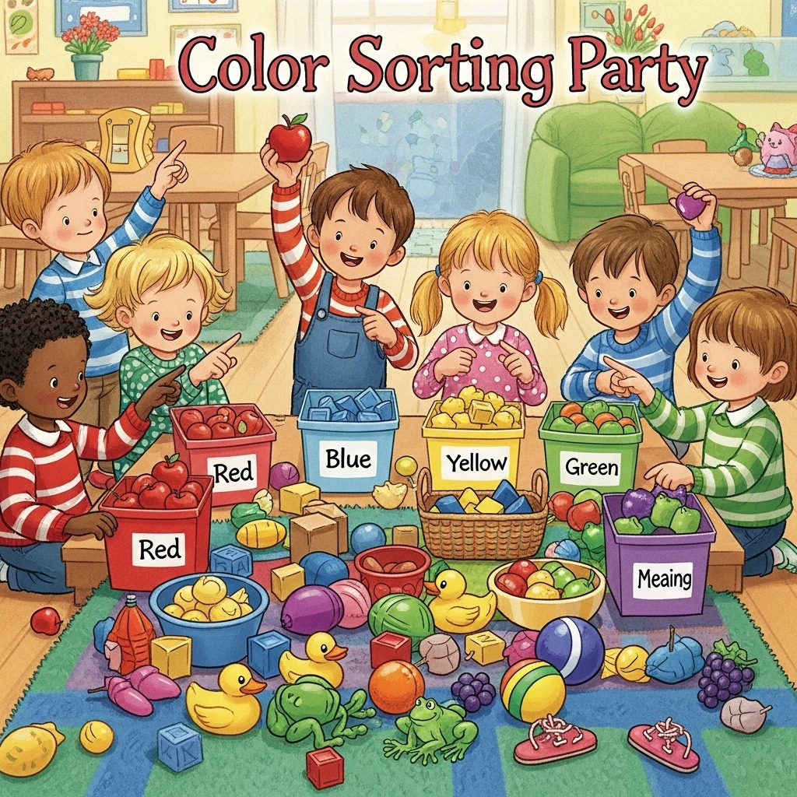
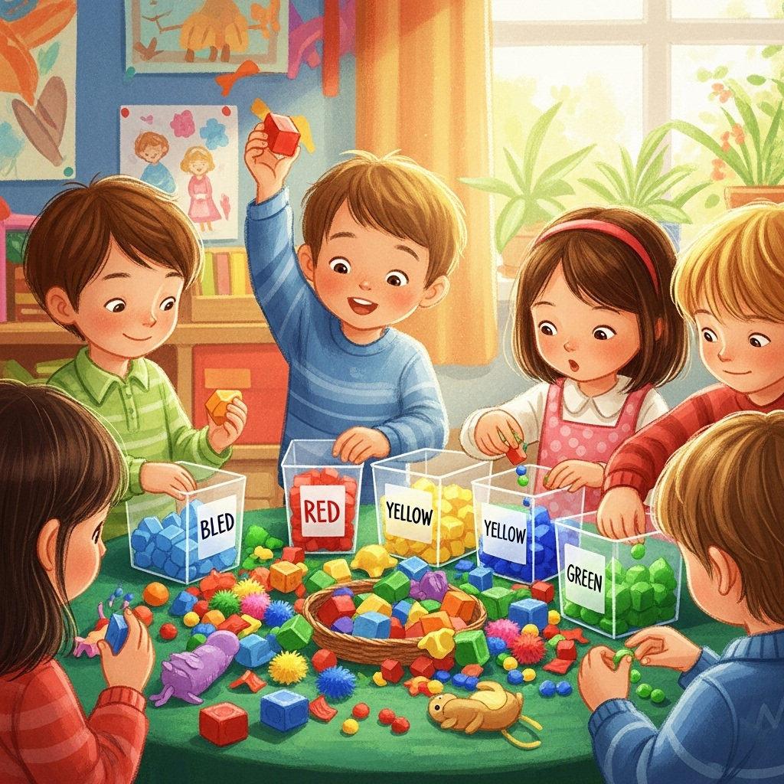
Age Group: 4–5 Years
Activity: “Color Sorting Party”
Materials Needed:
Colourful pom-poms or blocks (red, blue, green, yellow)
Bowls or baskets in matching colors
A music player (optional, to make it rhythmic)
Learning Objective:
To identify and name primary colors.
To practice sorting and matching by color.
Description:
Spread colourful pom-poms/blocks on a table or floor.
Place bowls of the same colors at one end.
Children pick one item at a time and place it in the correct color bowl.
Teacher encourages children to say the color name while sorting.
Optionally, play background music and stop it for a “freeze” game during sorting.
Summary:
This activity reinforces color recognition through hands-on sorting. It promotes attention, categorization, and builds vocabulary in an engaging way.

Slide 4
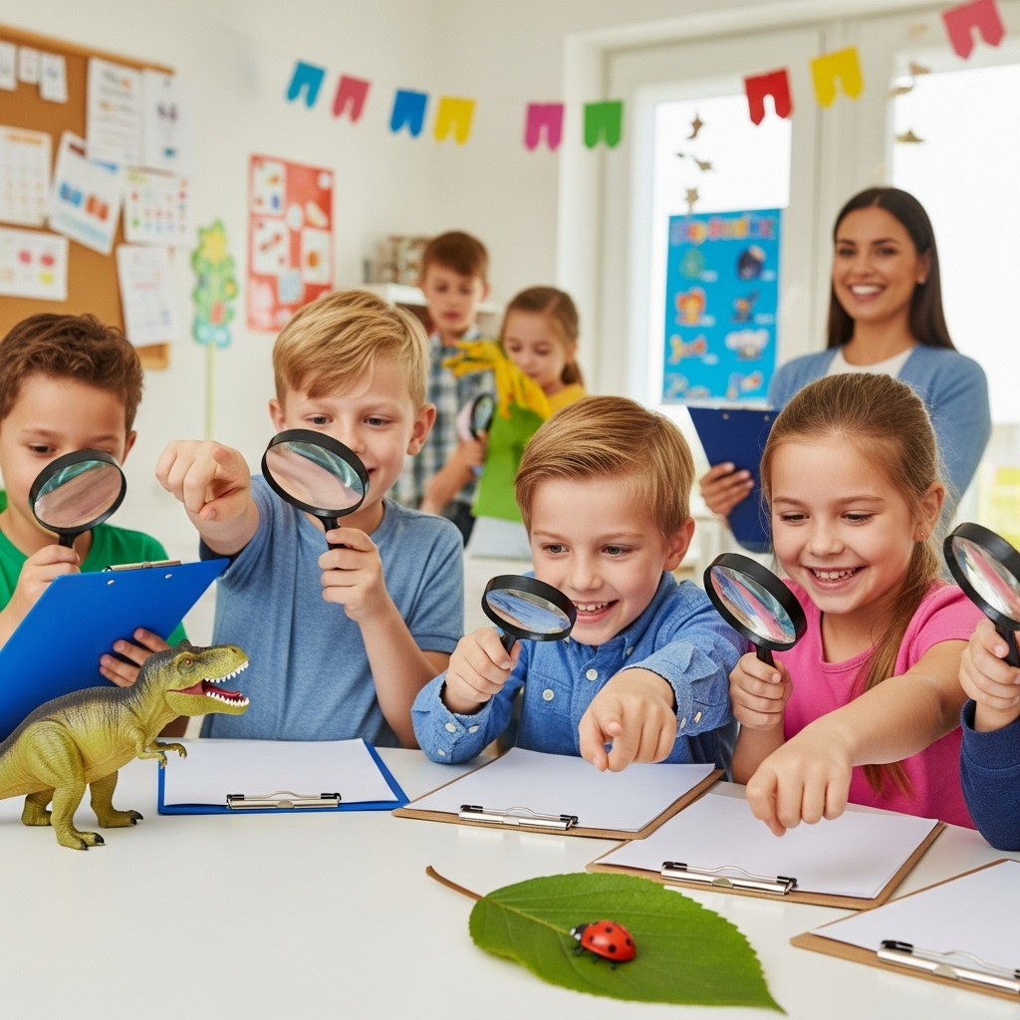

Age Group: 5–6 Years
Activity: “Big and Small Detective”
Materials Needed:
A collection of objects in two sizes (e.g., big ball & small ball, big spoon & small spoon, big teddy & small teddy)
A sorting tray or mat with labels “Big” and “Small”
Learning Objective:
To compare and classify objects based on size.
To develop reasoning and vocabulary related to comparison.
Description:
Display pairs of objects (one big, one small) on a table.
Ask children to pick an object and decide if it belongs in the “Big” or “Small” section of the tray/mat.
Children explain their choice by saying: “This is a big ball” or “This is a small spoon.”
Once done, mix items and let children practice independently.
Extend by asking questions like: “Which ball is bigger?” or “Find something smaller than this teddy.”
Summary:
Through active participation, children practice comparing objects and using size-related language. This builds early mathematical thinking and classification skills.

Slide 5
Overall Summary
The activities designed for children aged 3 to 6 years provide a progressive learning pathway using play-based, hands-on experiences.
At 3–4 years, children explore shapes through a fun “Shape Hunt Adventure,” which strengthens recognition, observation, and vocabulary.
At 4–5 years, children engage in a lively “Color Sorting Party,” reinforcing color identification and categorization through movement and interaction.
At 5–6 years, children act as “Big and Small Detectives,” learning to compare and classify objects by size, enhancing reasoning and early mathematical skills.
Together, these activities support children’s cognitive development, language growth, and problem-solving abilities, while keeping learning engaging and age-appropriate. They also encourage active participation, collaboration, and confidence building in early learners.

