Slide 1
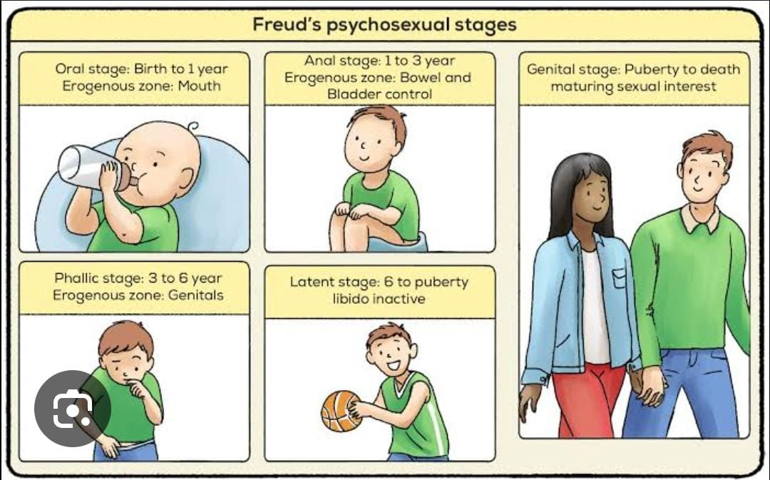
Observe a child of your choice and find out in which stage he/she is in, according to the psychosexual, psychosocial and cognitive theories of development.
I would like take my student as an example who is a 2.3 year old child in my class. At this stage , she is exploring the world with great curiosity and energy. She is developing new skills everyday, from taking first steps to tying out new sounds and words. She enjoys interacting with toys, observing people around, and responding with smiles and gestures. It’s a joy to watch her grow, learning, and express her unique personality.
Psychosexual stage

Slide 2
oral stage - The oral stage is the first stage in Sigmund Freud's theory of psychosexual development, spanning from birth to approximately 18 months of age. During this stage, the infant's primary source of pleasure and gratification is centered around the mouth and oral activities. This includes activities like sucking, biting, and chewing, which are crucial for feeding and also serve as sources of comfort and exploration.
Anal stage-The anal stage is the second stage, occurring roughly between the ages of 1.5 and 3 years. During this stage, the child's focus of pleasure shifts from the oral zone to the anus, with bowel and bladder control becoming the primary source of gratification. Toilet training is a key experience during this period, and how parents manage this process can significantly impact the child's personality development, potentially leading to either an "anal retentive" or "anal expulsive" personality.
Toddlers learn to control bowel movements, and the focus of pleasure shifts to the anus. Now she is learning to use the potty and feels a sense of accomplishment when she successfully uses it.
Fixation or conflicts during this stage can lead to personality traits like:-
Orderliness
Stubbornness
Punctuality
Obsessiveness

Slide 3
Psychosocial development
Psychosocial development refers to how personality develops and how social skills are learned throughout a person's life, from infancy to adulthood. It focuses on the interaction between psychological factors and the social environment. Erik Erikson's theory of psychosocial development outlines eight stages, each with a specific conflict or crisis that shapes personality and social skills.
Psychosocial development in children can be clearly observed in the classroom setting. As children interact with their peers and teachers, they begin to develop a sense of identity, confidence, and social understanding. Now during group activities or playtime, she learn to cooperate, share, and resolve conflicts, which contributes to their social skills. we can see the development of autonomy as she start making choices, she show initiative by taking responsibility for their work or helping others.
Teachers also play a crucial role in supporting this development by creating a safe and encouraging environment where students feel valued and understood. Through daily routines, classroom responsibilities, and peer interactions, children gradually build emotional resilience, empathy, and a positive sense of self.

Slide 4
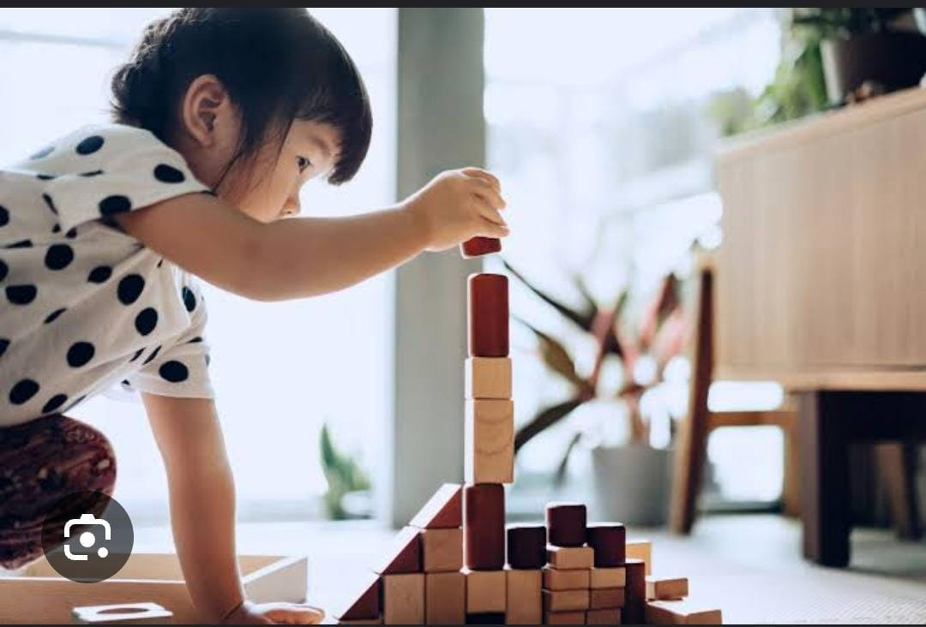
Cognitive theory
Cognitive development refers to the growth of mental abilities like thinking, learning, and memory, from infancy through adulthood. It encompasses how individuals perceive, think, and understand their world, including problem solving and the development of knowledge. This development is influenced by both genetics and learning experiences.
Sensorimotor stage: Birth to 2 years
Preoperational stage: Ages 2 to 7
Concrete operational stage: Ages 7 to 11
Formal operational stage: Ages 12 and up

Slide 5
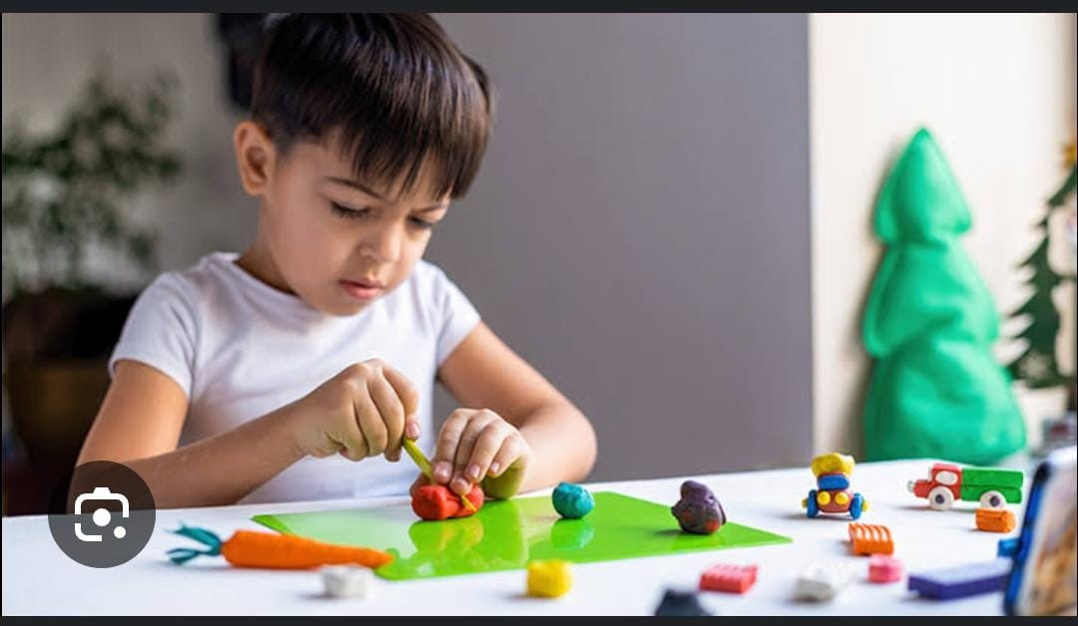
Now she is learning through basic actions such as sucking, grasping, looking, listening and Learn that things continue to exist even when they cannot be seen (object premanence) also Realize that their actions can cause things to happen in the world around them.
She is also stated think symbolically and learn to use words and pictures to represent objects and tend to be egocentric and struggle to see things from the perspective of others also getting better with language and thinking, but still tend to think in very concrete terms.

Slide 6
Thankyou

