Slide 1
Observe the child of your choice and find out in which stage he/ she is in, according to the Psychosexual, Psychosocial and cognitive theories of development.
Assignment - 3

Slide 2
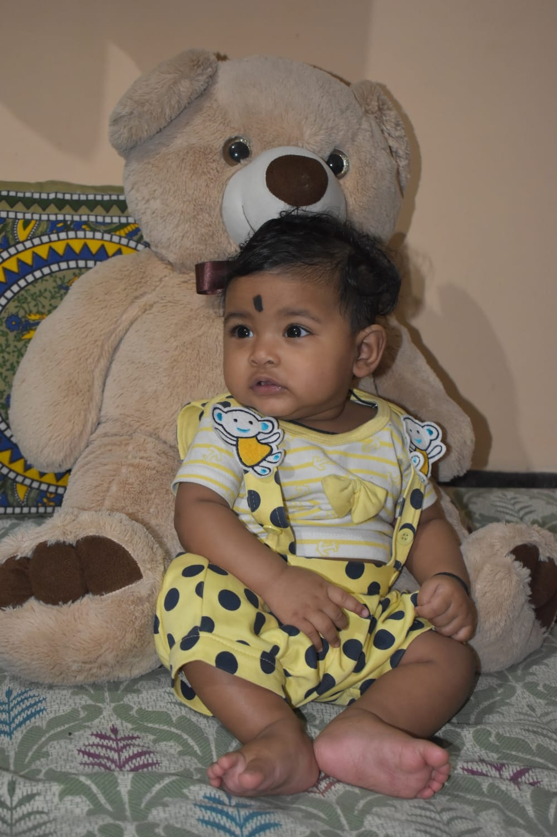
Child : Shanvika (7 month old)

Slide 3
🧠 Freud’s Psychosexual Stage: Oral Stage (0–1 year)
Behavior: Puts toys, hands, and anything she finds into her mouth
Example: She sucks her fingers when sleepy or chews on a teether.
🤝 Erikson’s Psychosocial Stage: Trust vs. Mistrust
Behavior: Cries when her mother leaves and calms down when held
Example: Smiles when mom talks to her or feeds her on time.
🧩 Piaget’s Cognitive Stage: Sensorimotor Stage
Behavior: Reaches for toys, responds to sounds, recognizes faces
Example: She turns her head toward mom’s voice or grabs a rattle.

Slide 4
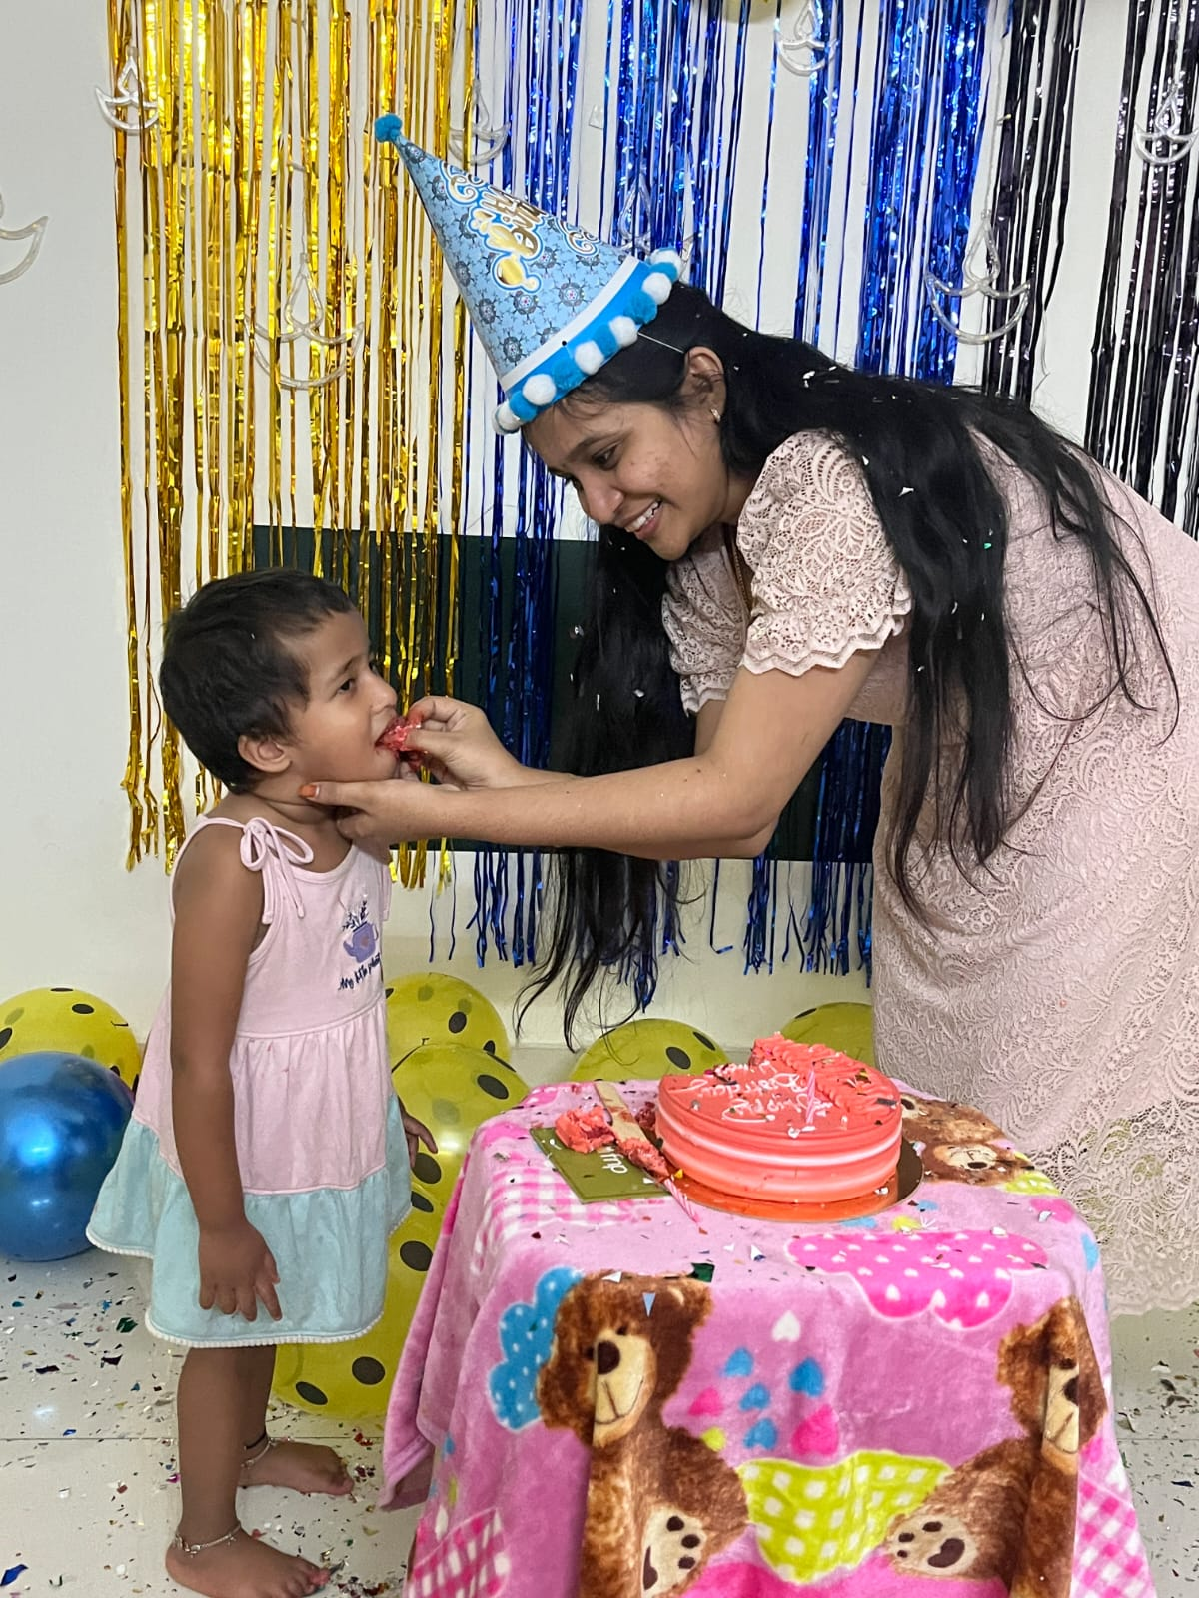
Child: Shanvisha (2 years old)

Slide 5
🧠 Freud’s Psychosexual Stage: Anal Stage (1–3 years)
Behavior: Enjoys toilet training but says “No” to it sometimes
Example: Wants to flush the toilet herself, but may resist help.
🤝 Erikson’s Psychosocial Stage: Autonomy vs. Shame and Doubt
Behavior: Wants to do things himself — like eating, dressing
Example: Says “I do!” when you try to tie his shoes.
🧩 Piaget’s Cognitive Stage: Sensorimotor Stage (Late Phase)
Behavior: Uses pretend play and names objects
Example: Uses a spoon as a toy phone and says “hello.”

