Slide 1

Cover page
Observing a Child’s Development:
Analyzing Her Stage Based on Theories by
Freud, Erikson, and Piaget
Assignment 3 by Nishigandha Joshi

Slide 2

KIDS PROFESSIONAL COLORING BOOK – PICTURE 1
Child Profile :
Age- 4 years 11 months
Gender- Female
Relationship- Niece
Siblings- None (single child)
Attends pre-school (Sr.Kg)
Lives with parents and grandparents
Physical Abilities- Runs, jumps, climbs confidently
Cognitive Skills- Speaks fluently in full sentences (in English and her mother tongue Marathi), asks many questions, loves pretend play
Social Behavior- Friendly, curious, loves playing with friends & cousins, takes time to open up to strangers but very comfortable with those she knows well
Interests- Enjoys drawing, playing doctor-doctor and dressing up (shopping for her clothes, hair accessories)

Slide 3
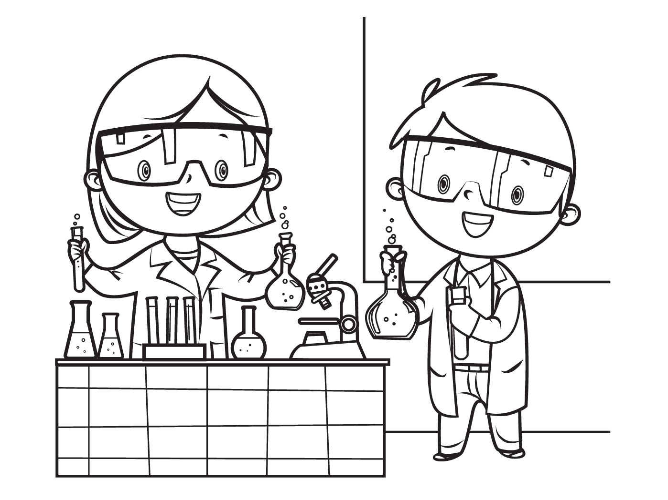
KIDS PROFESSIONAL COLORING BOOK - PICTURE 2
Observation of My Niece:
Freud’s Phallic Stage (Gender Awareness & Parental Attachment)
What I saw: My niece asks about gender differences (why boys and girls are different) She showed preference for one parent over the other (like wanting to be with mom more often)
Example: My niece knows that my husband doesn’t have long hair because he’s a boy and I do because I’m a girl. She also enjoys spending time with her mom more, which is typical for this stage.
Erikson’s Initiative vs. Guilt (Leading & Learning)
What I saw: My niece doesn’t like taking a lead in play (she’s more of a follower in pretend play) , she shows excitement to try new things (karate) She gets very upset when told ‘no’ or asked to apologize
Example: In games such as doctor-doctor, she’s happy being the nurse.
Piaget’s Preoperational Stage (Imaginative Play & Egocentrism)
What I saw: She likes engaging in pretend play (pretending to cook, act like a teacher) She has trouble understanding that things don’t change just because they look different (pouring water into a different-sized glass)
Example: She loves pretending to cook and serve food to her stuffed animals. When I changed the shape of her cookie, she thought it was a different flavor, showing she’s still learning about conservation.

Slide 4
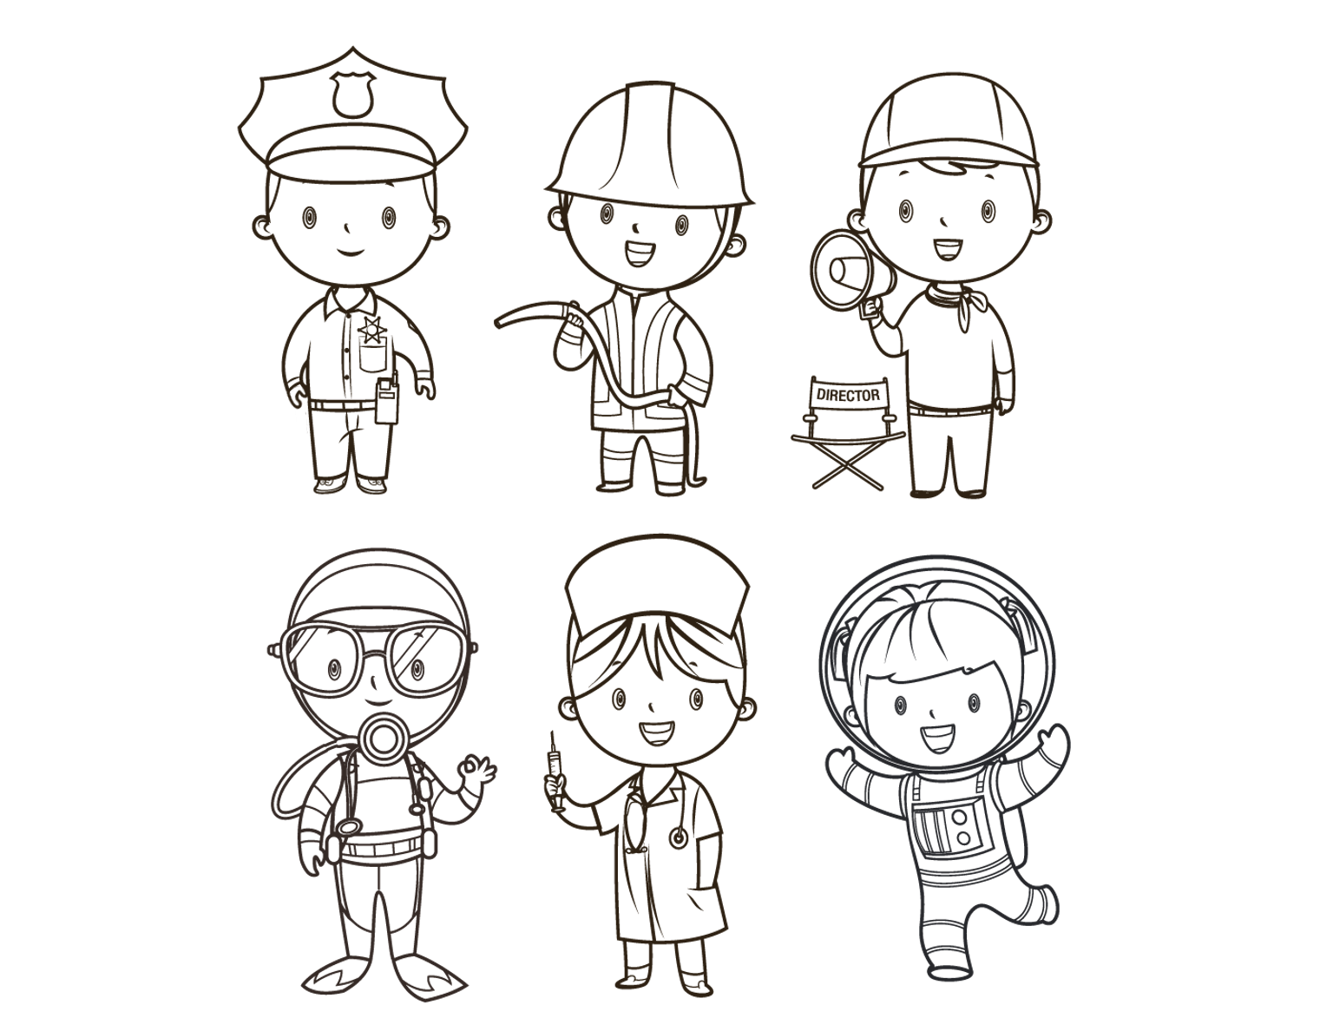
Analysis of Her Stage:
Freud’s Stage:
Based on my observations, my niece seems to be in Freud’s phallic stage. She is very interested in gender differences and has a clear preference for spending time with her mom.
Erikson’s Stage:
My niece is in Erikson’s initiative vs. guilt stage. She’s still navigating that initiative vs. guilt balance wanting to contribute but fearing making mistakes or overstepping.
Piaget’s Stage:
My niece is in Piaget’s preoperational stage. She enjoys pretend play and shows signs of egocentrism, like thinking the shape of her cookie changes its flavor.

Slide 5
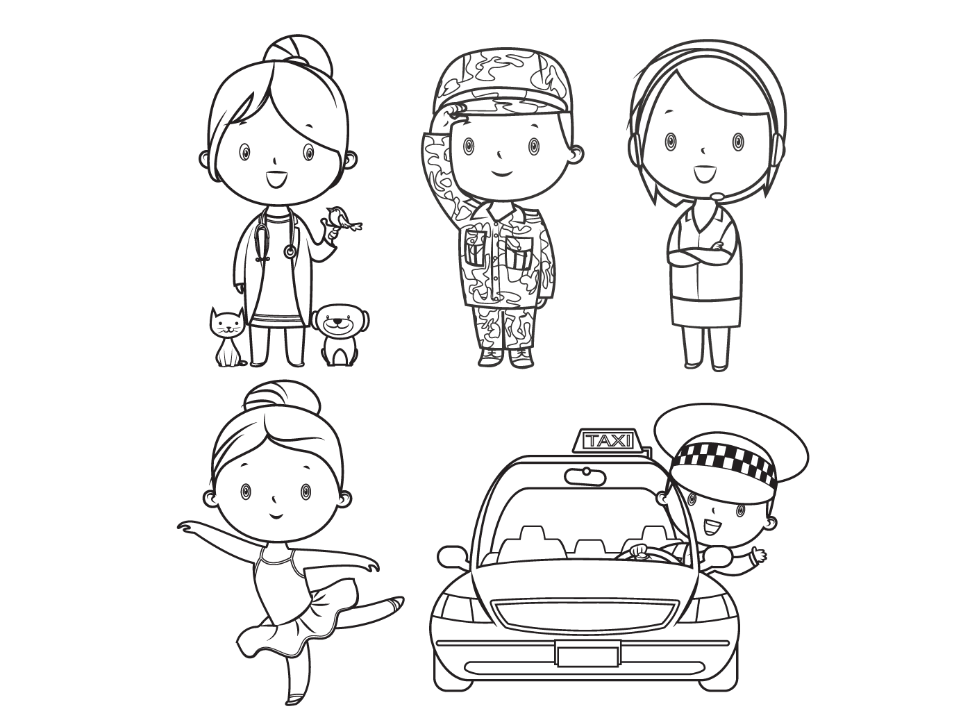
KIDS PROFESSIONAL COLORING BOOK - PICTURE 6
In conclusion…
Observing her reminded me that every small choice a child makes is a step toward understanding themselves and the world around them.

