Slide 1
Pre –k class
The learning center activities are marked as child-led and facilitator-led activities. They are planned in such a way that both child-led activities can be provided, and the children can be encouraged to choose between them (in the case of two child-led activities). Once they have completed, the groups should be exchanged. While some children are engaged in child-led activities, the facilitator-led activity can be done with the rest. Ensure that:
• Child-led activities are explained to the children first.
• They should be encouraged to do all the activities regardless of the chosen activity
• The facilitator to make sure that conversation points are used to summarize the child-led activity or use them while the activity is in progress for observation purposes.
• Supervision is mandatory for child-led activities too
To ensure the safety of the children ,caregivers can be in charge of child led activities and facilitators will be supervising the class.
Theme of the week –General Awareness –
Sea animals Math and Logic: Number 7
Language and Literacy-’m’
From: Jayapriya G

Slide 2
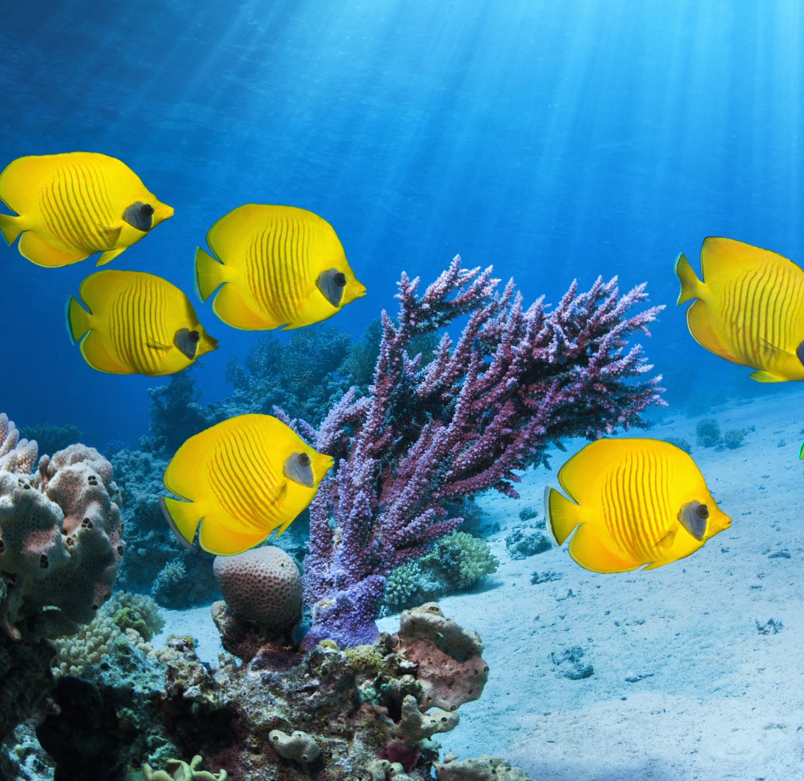
General Awareness:
Sea Animals

Slide 3
General Awareness
Introducing sea animals to a 3-year-old can be a fun.
1. Show the model of this aquarium and let the children explore. Allow children to speak about what they know. Later teacher can Point to the fish and say, “Look, a fish! Fish live in the water and swim with their fins.” Children will start speaking about the sea animals they already know.
Explain that this is an aquarium.
2.Visit an aquarium or a local beach to observe marine life in person.
By making it fun and interactive, we can spark child’s curiosity and help them learn about the amazing world of sea animals!

Slide 4
Discovery Centre
Facilitator –led activity
Children to explore the sand tray and search for animal picture and later fix the
Puzzle.Children explore the textures, shapes, and potentially practice fine motor skills by making imprints in the sand with the stencil of sea animals.

Slide 5
Sensory Center
Child-led activity:
Sensory activities for sea animals can be a fun and educational way for children to learn about ocean life. Use a large bin or tub filled with water, blue food colouring (optional), and various sensory materials like sand, shells, smooth stones, and artificial seaweed .Add plastic or rubber sea animal toys like fish, sharks, dolphins, and turtles. Children can explore the textures, scoop up the animals, and engage in imaginative play about the ocean and speak about sea animals.

Slide 6
Role play
Facilitator –led activity
Sea Animal Friends:
Children can take on the roles of different sea animals, interacting with one another
in their underwater world. They can mimic the movements and sounds of the
creatures, building social skills and creativity.
Objective: physical, social and Emotional development .
This activity encourages cooperation, collaboration, and empathy as children work
together and take on different roles.

Slide 7
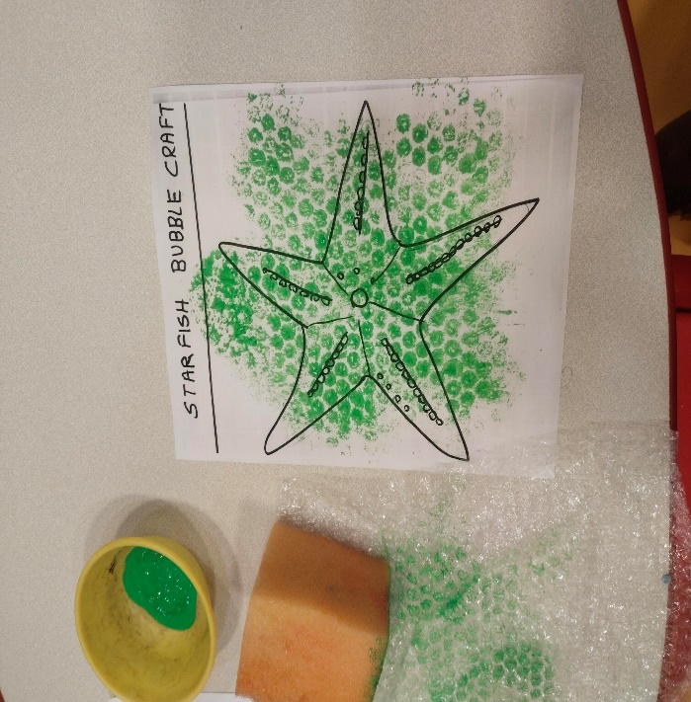
Art center : Bubble wrap art
Facilitator –led activity
Use a paintbrush or sponge to apply paint to the bubble side of the wrap.
You can use one color or multiple colors for a more dynamic effect.
Gently press the painted bubble wrap onto the paper.
Carefully peel off the bubble wrap to reveal the bubble print.
Once the paint dries, child can add additional details or outlines with markers,
paintbrushes, or other art materials.
Objectives:
Develop artistic expression : This activity allows children to express themselves creatively and explore their artistic abilities.

Slide 8
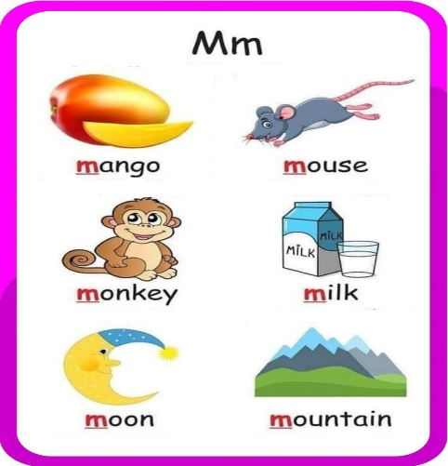
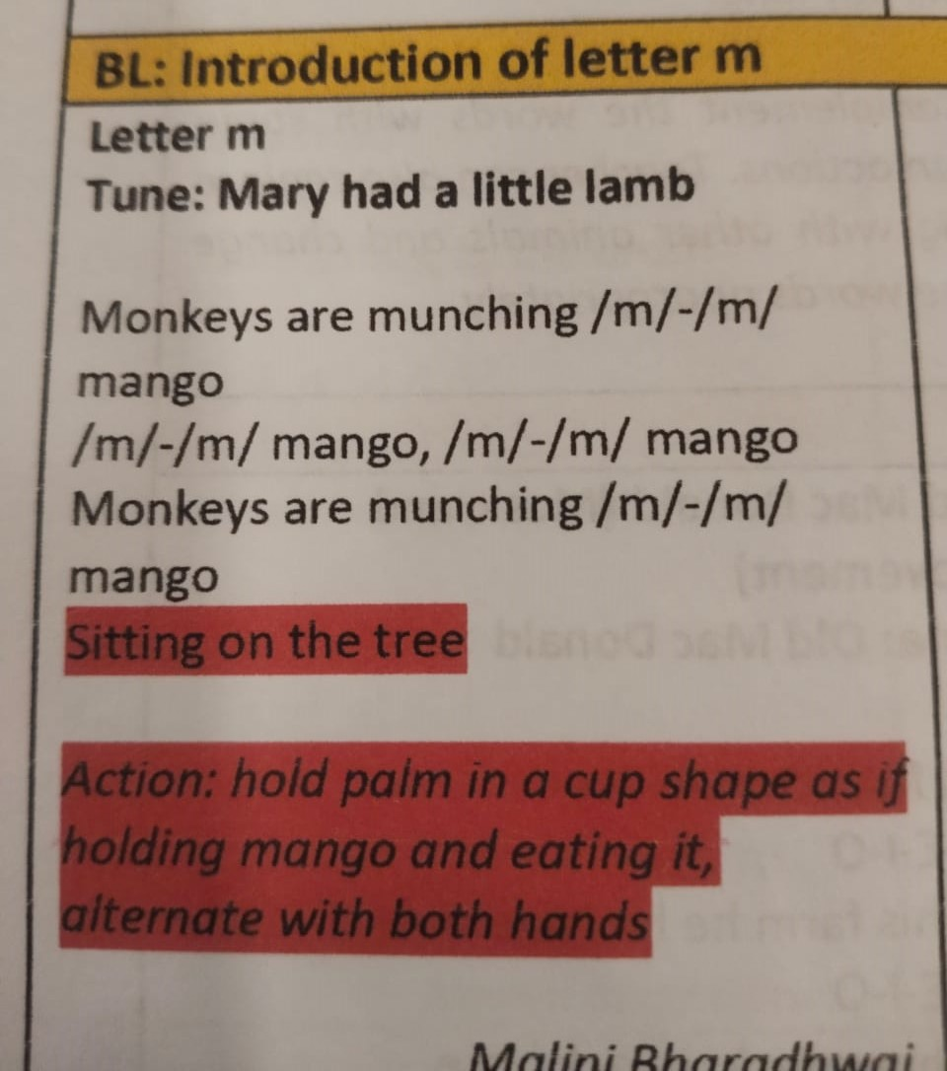
Introduction of letter m
Introduction of letter m :Tell the child that they're going to learn about the letter m .Show them the letter , objects of letter m and make its sound.
Sing the phonic song and do air tracing.

Slide 9
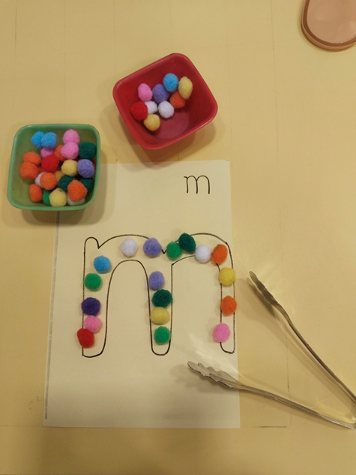
Language center- Place pompom/ counter activity
Facilitator –led activity
This activity is great for 3-year-olds to learn the letter "m" while also developing their fine motor skills.
1.Prepare the materials : Draw a large letter "m” on a piece of paper or cardboard . Gather various small objects like bottle caps, buttons, or pompoms in different colors or counters.
2.Let the child place the counters or pom poms on the letter m
The objective of this literacy activity are-
Letter formation : To introduce the correct formation of the letter "m" by tracing the outline.
Pre-writing skills : To develop pre-writing skills by encouraging children to trace the letter with their fingers or other objects.

Slide 10
Sensory center
Child-led activity:
To introduce letter formation :This activity provides a tactile and engaging way for children to practice forming the letter "m", preparing them for writing the letter on paper . To promote sensory exploration . Working with play dough engages the sense of touch, providing a calming and enjoyable sensory experience.
Objective : This sensory center activity is designed to help children learn the letter "m" through tactile and visual experiences .
Multisensory learning : This approach engages multiple senses, which can help children learn and remember information more effectively.

Slide 11
Math center
Facilitator –led activity
Roll the dice game :
1.Distribute the worksheets to the children.
2.Explain the activity: "We will roll the dice, and then count the number of times the
letter 'm‘ appears on the worksheet.“
3.Demonstrate rolling the dice and counting the letter “m” on the worksheet.
4. Have the children take turns rolling the dice.
5. After rolling the dice, ask the child to count the number of times the letter "m" appears
on the work Sheet
6. Encourage the child to place the sea animal counters on letter m on the worksheet.
7. Repeat the activity several times, allowing each child to participate.
Objective: children will recognize the number on dice and count letter m.

Slide 12
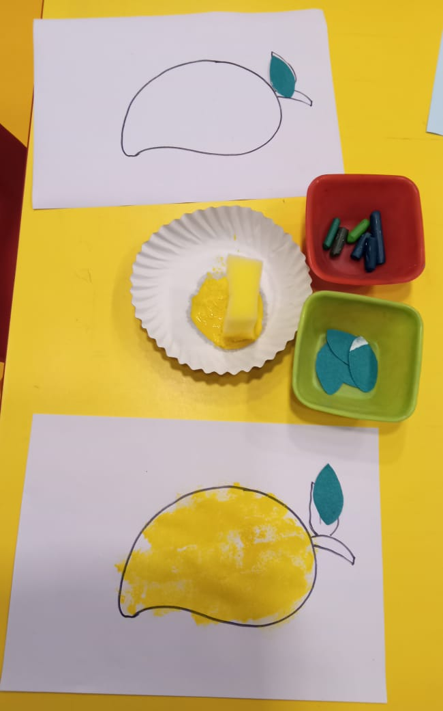
Art centre
Facilitator –led activity
Sponge dabbing:
Sponge dabbing for letter m objects involves using a sponge dipped in paint to fill in the shape of an object that starts with the letter m such as a mango, moon, or mountain.
1. Prepare the materials : Gather a sponge, paint (e.g., yellow for a mango), a paper with the outline of the m object, and a plate or tray to hold the paint.
2. Dip the sponge : Dip the sponge into the paint, ensuring it's evenly coated but not overly saturated.
3. Dab the sponge : Gently press the sponge onto the paper within the outline of the object. Let children repeat this process until the entire shape is filled in.
4 .Add details : Once dry, child can add details like stems, leaves, or facial features using markers, crayons, or other art supplies.

Slide 13
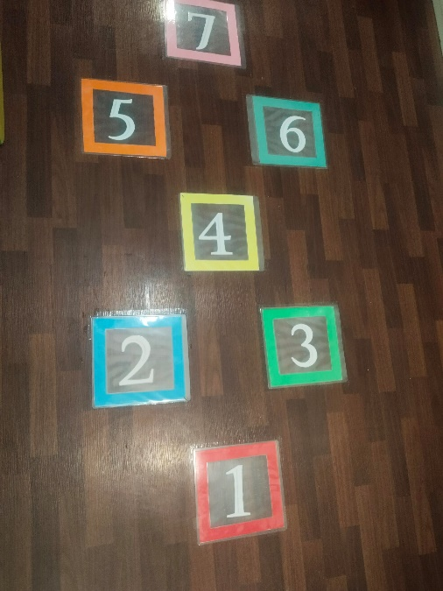
Introduction of number 7
Preparation
Number 7 Card: Prepare a large, colorful number 7 card or poster.
Number 7 Toys: Gather 7 toys or objects, such as blocks, counting bears, or toy cars.
Show the Number 7 Card: Show the child the number 7 card and say, "This is the number 7
Count Together: Count the 7 toys or objects together with the child, pointing to each object as you count.
Repeat the Count: Repeat the count several times, encouraging the child to join in.
Reinforcement
Number 7 Rhymes: Recite a simple rhyme or song that incorporates the number 7, such as “There are seven days".
Number 7 Game: Play a simple hopscotch game.

Slide 14
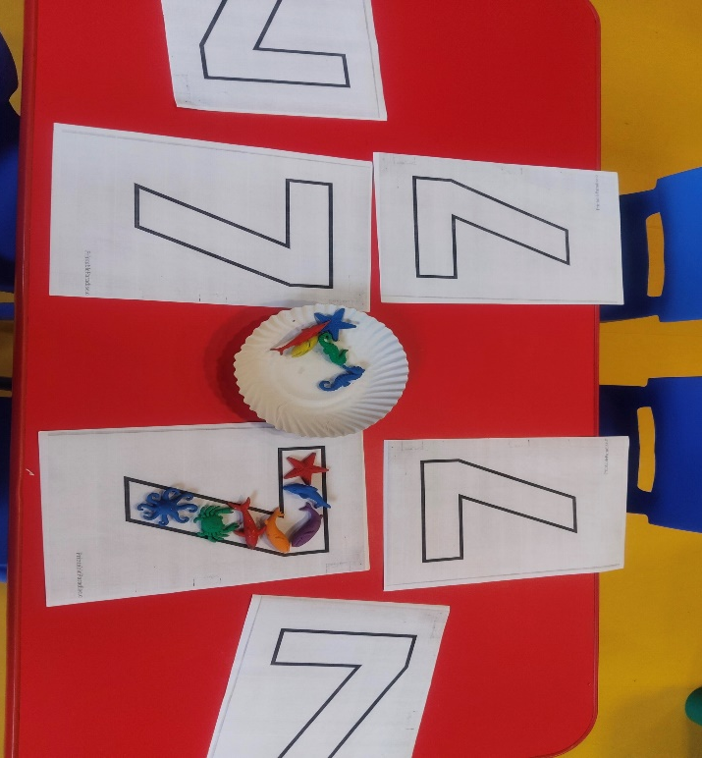
Math center
Facilitator –led activity
1.OMO – Colour the worksheet.
2.Sea animal count-Lets look at all the colorful sea animals! Can you name them? We have a whale, a shark, a dolphin, a crab, an octopus, and a starfish. Let's count the sea animals on the number 7. They are all swimming in the shape of the number 7.

Slide 15
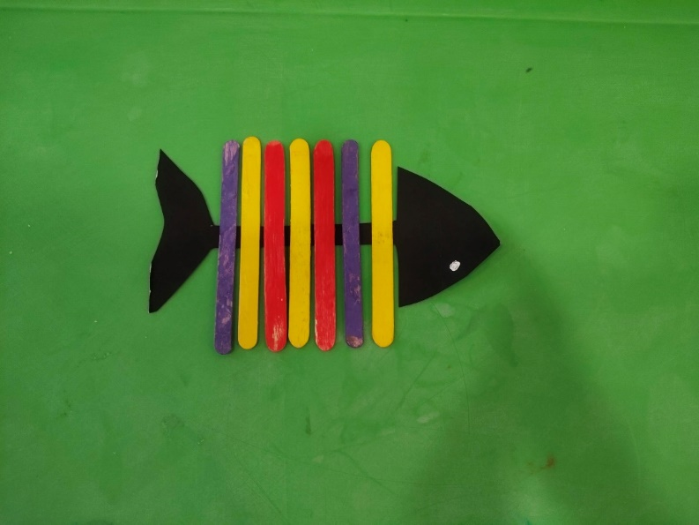
Art center
Facilitator –led activity
Popsicle fish Art -This popsicle stick fish craft can be fun way to teach a 3-year-old about the number 7.
Activity:
Teacher to give cut out of a fish shape from paper or cardboard, and arrange materials . Children will count and decorate . Let the child count out 7 popsicle sticks. They can then decorate each stick with markers, paint, or other materials . Glue the decorated popsicle sticks to the fish base, counting each one as they do so . Add fins, a tail, and draw eyes to complete the fish.
Number recognition: This activity helps child to recognize the numeral 7 and associate it with the quantity 7.
Objective:
Creative Expression: To explore different types of art materials.

Slide 16
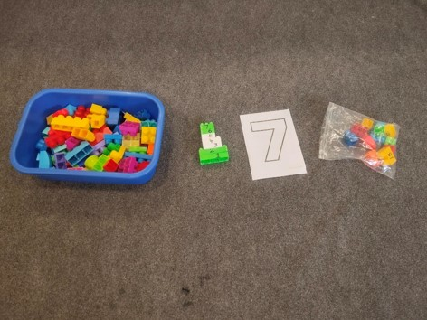
Block centre
Child-led activity:
Activity- Number tower
Begin by introducing the number cards .Show how to build a tower using the blocks, starting with the number 1. Ask the child to build a tower using the blocks, with each block representing a number on the block. As the child builds the tower, ask them to count the blocks and identify the corresponding number. Encourage the child to build the tower up to 7 blocks, counting and identifying each number as they go. Once the tower is complete, ask the child to point to each number and count the blocks again.
Creating patterns-Children can use the blocks to create patterns with 7 repetitions (e.g., red, blue, red, blue, red, blue, red).
Learning Objectives :
Number Recognition: Children will recognize and identify the numeral 7.
Counting: Children will practice counting to 7.
Fine Motor Skills: Children will develop their fine motor skills by manipulating the blocks.
Creativity and Problem Solving: Children will use their creativity and problem-solving skills to build structures with 7 blocks.
Literacy: Children can practice writing the number 7.

Slide 17
Language center
Facilitator –led activity
Provide children with laminated sheet as shown in the image . This can be used for all numbers. The sheet must have three columns which say – Say it, build it and count it.
Say it – will have the number that is introduced
Build it – will have the hollow letter of the number where they can roll play dough or color inside the hollow number
Count it- will have objects according to the numeral. If the sheet is laminated, they can be used for any number. Encourage the children to count sequentially and talk about before number.
Objective:
Creative Expression: To explore different types of art materials.

Slide 18
Thank You

